Slide 1
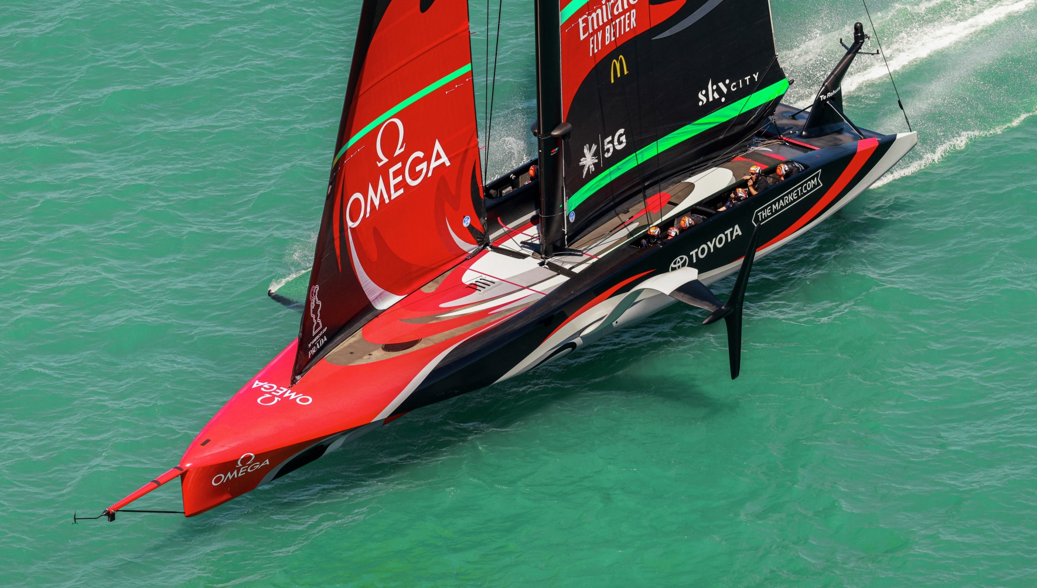


In Our Backyard
Sport NZ’s Learning with Sport framework
Notes:
In Our Backyard is Sport NZ’s learning with sport framework.
The framework guides sporting organisations, schools and kura in the use of a service design process to co-create, test, pilot and ultimately implement new ways of engaging with each other.
It also guides sporting organisations, schools and kura through a resource design process so that they establish classroom programmes that include quality learning experiences, that are aligned to the Ministry of Education’s ‘Understand-Know-Do’ framing for the New Zealand Curriculum, and that support Sport NZ’s aspirations for Tamariki and Rangatahi.

Slide 2
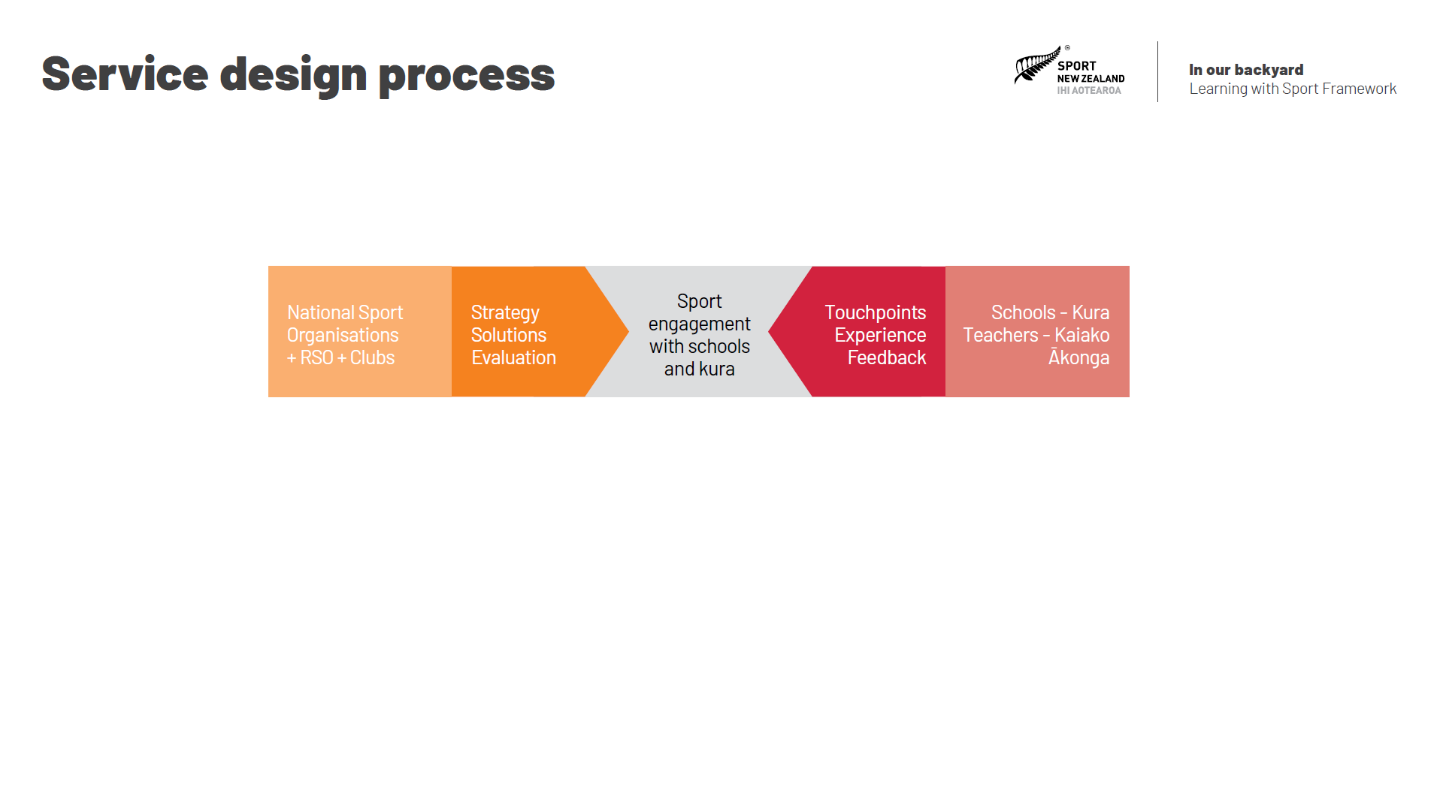
Notes:
Service Design is used around the world to design and improve services.

Slide 3
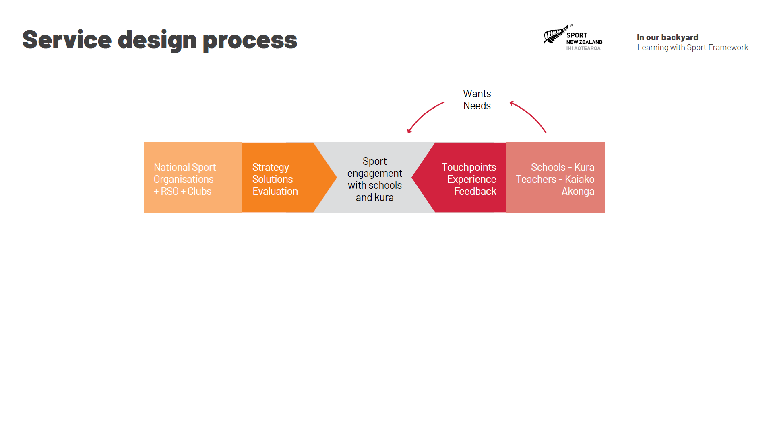
Notes:
In service design, the customer of the service is a key partner with the provider in designing how the service will work, and it is the customer’s needs and wants that determine the design of the service.

Slide 4

Notes:
The service provider will have resources that it can use to provide the service and will be constrained by what it does not have, but their wants and needs are always secondary to those of the customer during service design.

Slide 5
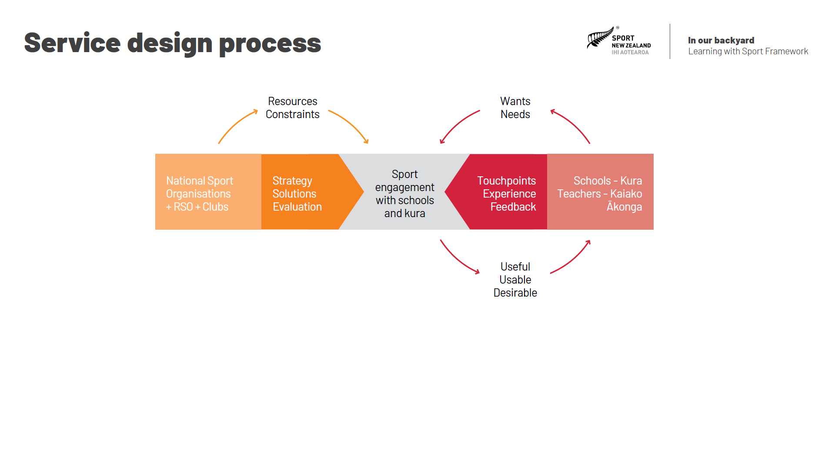
Notes:
Ultimately the goal is to create a service that the customer feels is useful, usable and desirable …

Slide 6

Notes:
… and which the provider finds effective and efficient to deliver.
In the ‘learning with sport’ context, the service we are talking about is sport engagement with schools and kura. The customer of the service is schools, kura, teachers, kaiako, and ākonga. The provider of the service is national sporting organisations, their regional organisations and their clubs. The national sporting organisations, regional sporting organisations and clubs bring a strategy and some solutions to the service design process. Schools, kura, teachers, kaiako and ākonga experience the service delivery and their feedback about touchpoints with the service are evaluated to inform the ultimate design of how the sport engages with schools and kura.

Slide 7
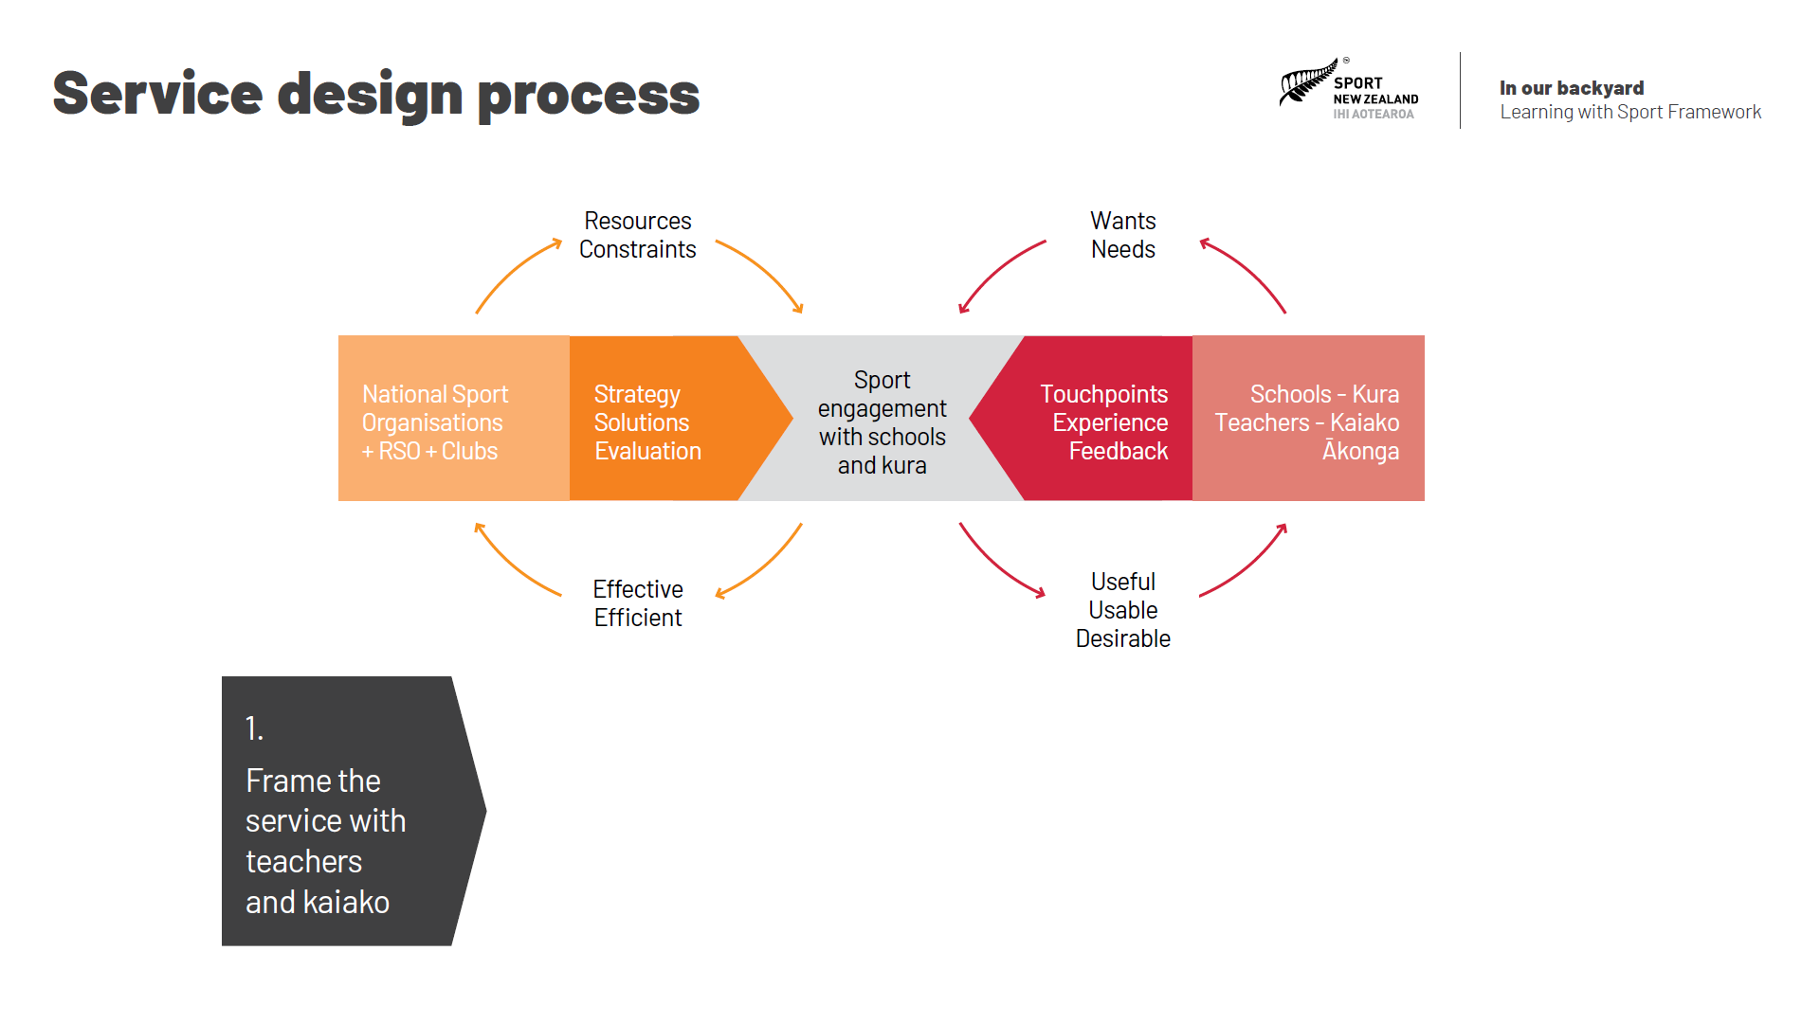
Notes:
The first step for national sporting organisations, their regional bodies and their clubs when working with schools, kura, teachers and kaiako is to frame up how they intend to engage with one another. Why does the sport want to engage with schools and kura?, what will this engagement include?, how might the engagement work?, and what will the sport, schools and kura get out of the engagement?, are all important questions to answer during this step in the process. Creating a high-level plan and an initial draft of a learning journey for the service are important outputs of the first step in the service design process.

Slide 8
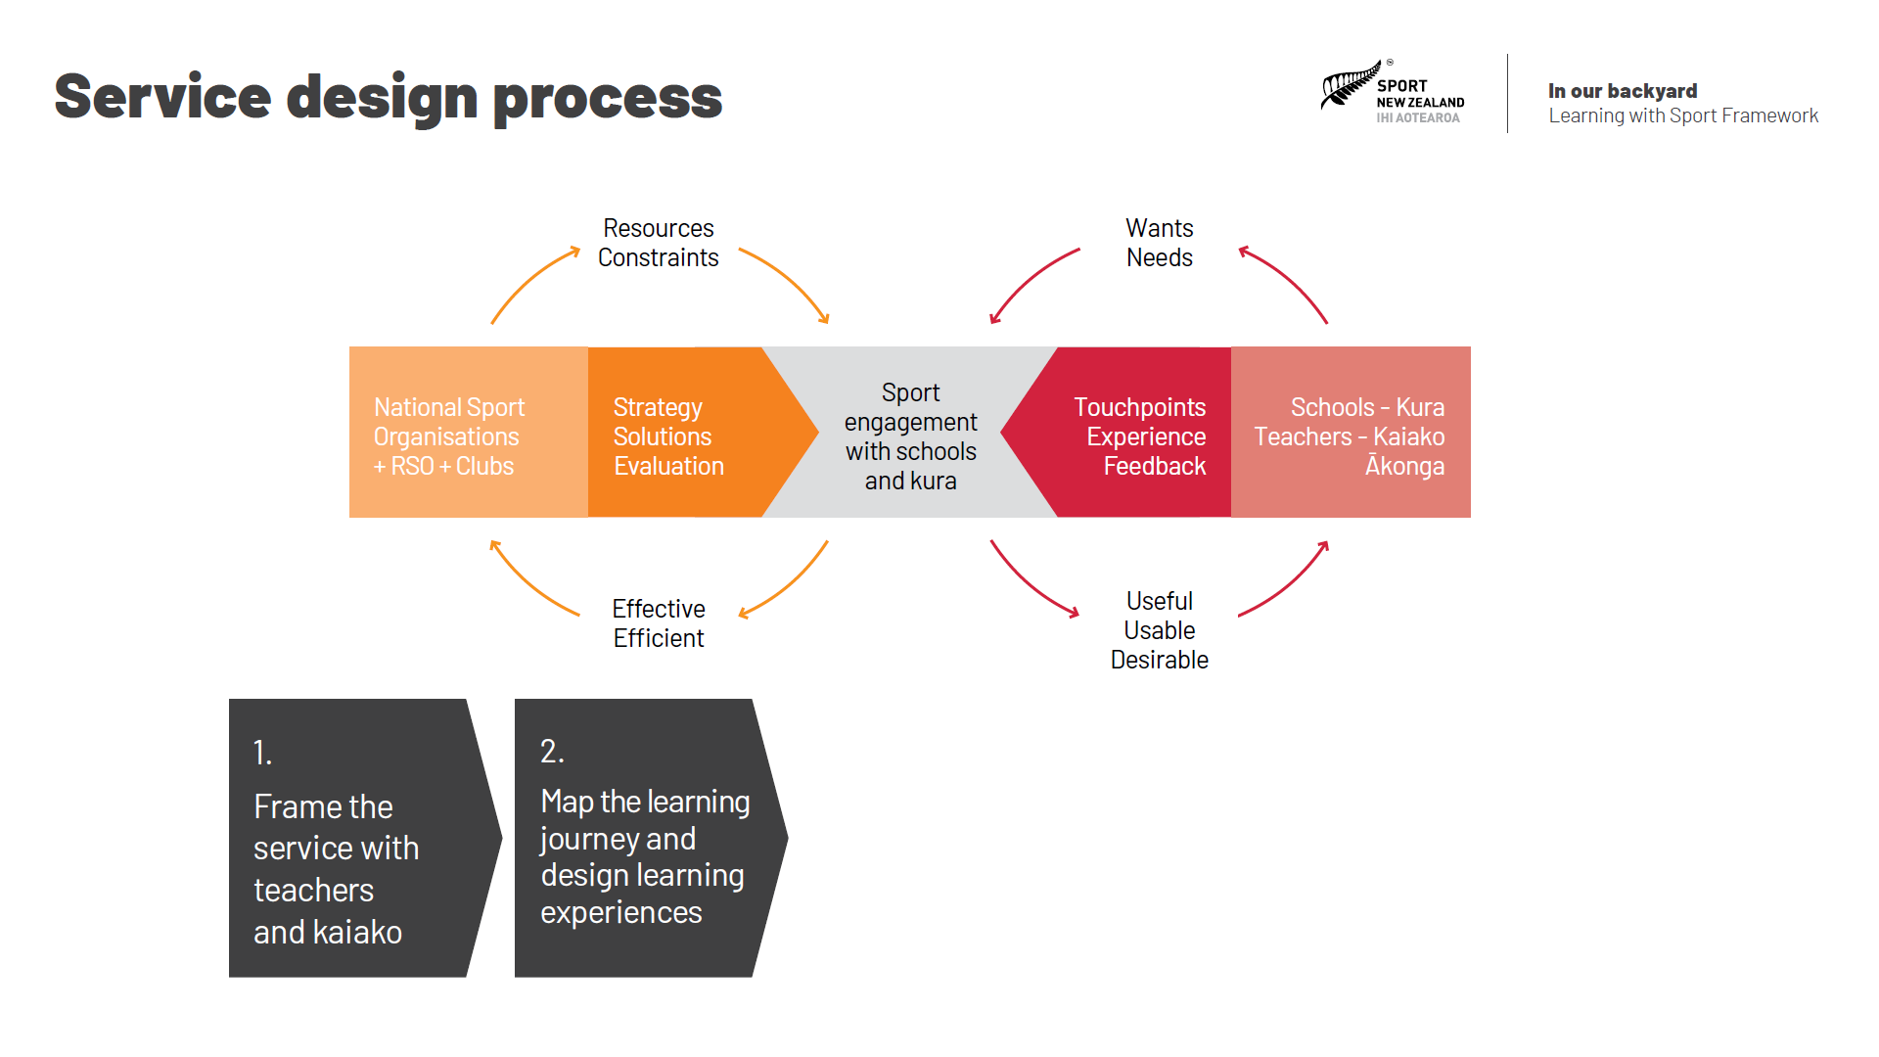
Notes:
Next it is important for teachers and kaiako to map out all the stages in the learning journey, from the point where they first hear about the service, through to the point where they have finished their engagement with it. Teachers and kaiako are asked to think of all the points at which they will connect with the sport during the engagement and then identify things that could go wrong, along with possible solutions that would minimise the likelihood of these things going wrong. This enables the national sporting organisation to commission the design of a prototype of the service, including a range of classroom-based experiences and club-based experiences that will ultimately form the learning with sport topic that underpins the service.

Slide 9
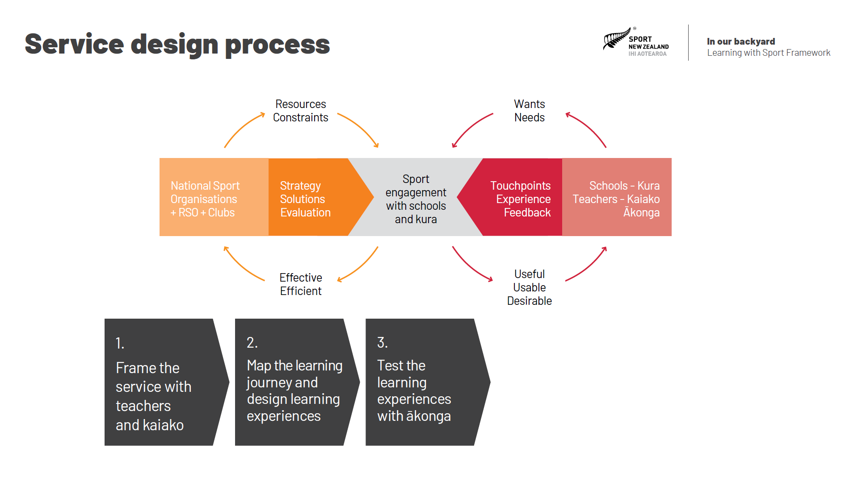
Notes:
The third step in the service design process is for the sport to test the learning experiences with small groups of ākonga. This gives them the chance to iron out any flaws in the design before they pilot the service with whole classes of ākonga. Individual classroom-based and club-based learning experiences are tested with small groups of ākonga, and their feedback about the experiences helps the sport to refine them further.

Slide 10
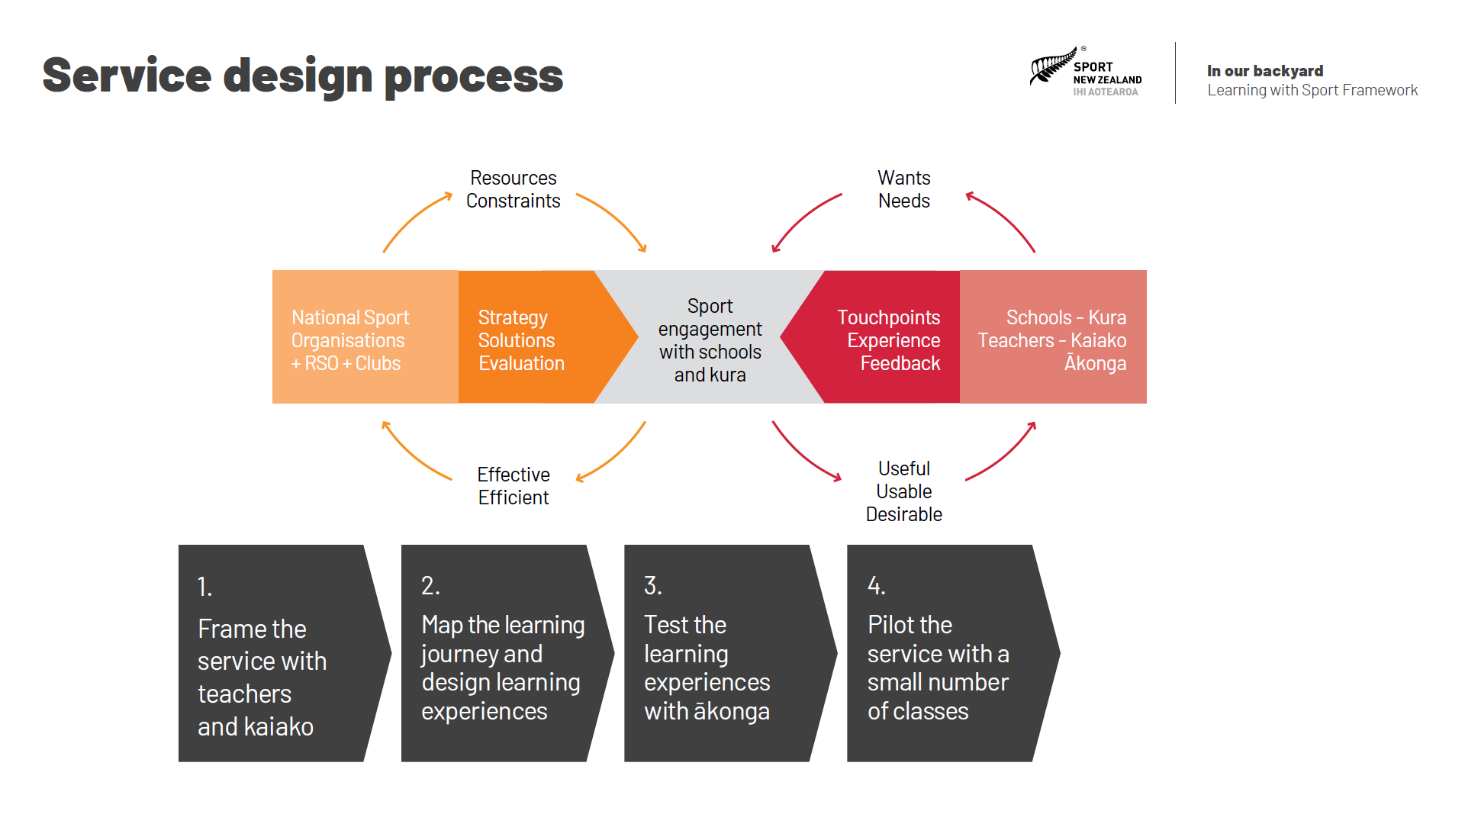
Notes:
The fourth step in the service design process involves piloting the service with a small number of classes. The aim is to test all the stages of the service from registration, to the implementation of the classroom-based experiences, through to the delivery of the club-based experiences. Once again, feedback from teachers, kaiako and ākonga is used to help further refine the learning experiences and shape the way in which the service will be delivered.

Slide 11
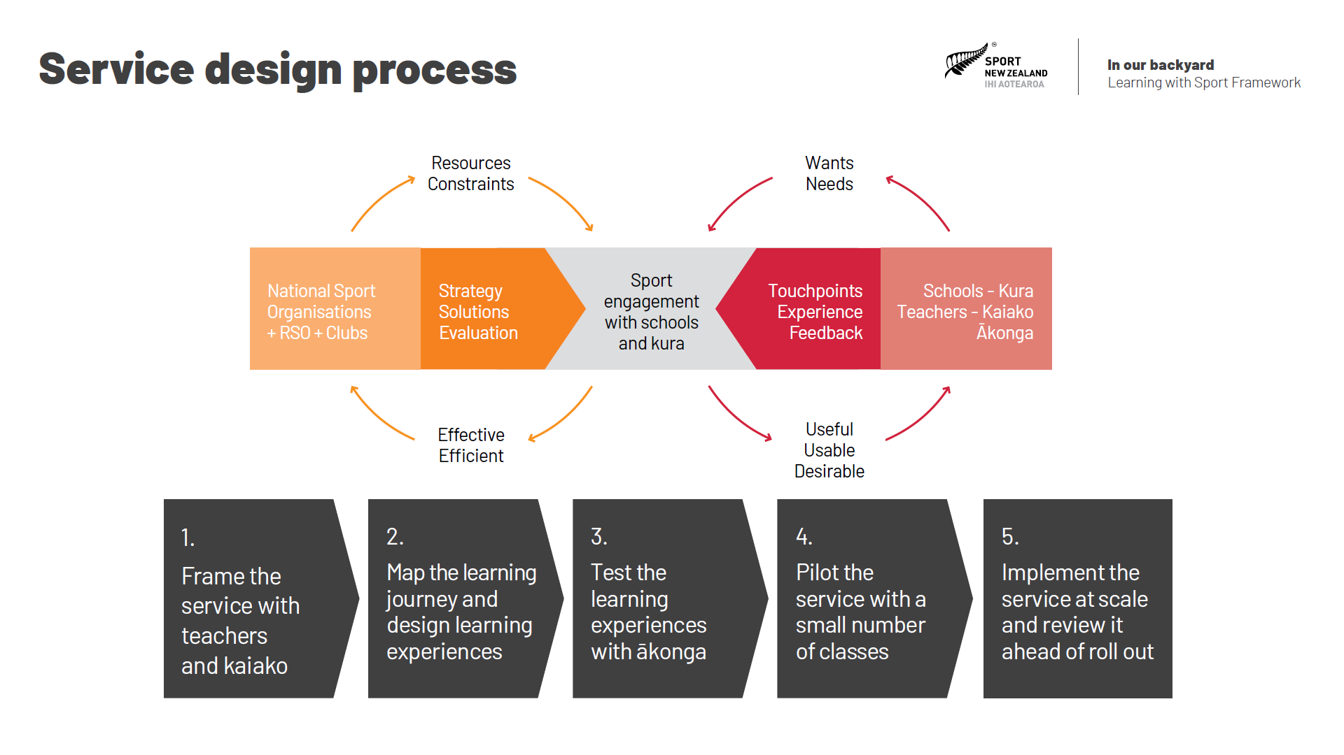
Notes:
The final step in the service design process is to implement the service at scale and review it ahead of roll out. This is often done in conjunction with a major sport event as it provides an extra catalyst and motivation for schools, kura and clubs to engage with one and other. Often hundreds of schools and kura will engage with the sport during these major events, providing an excellent opportunity to gain feedback about the service before it becomes the way in which that sport engages with schools and kura.

Slide 12
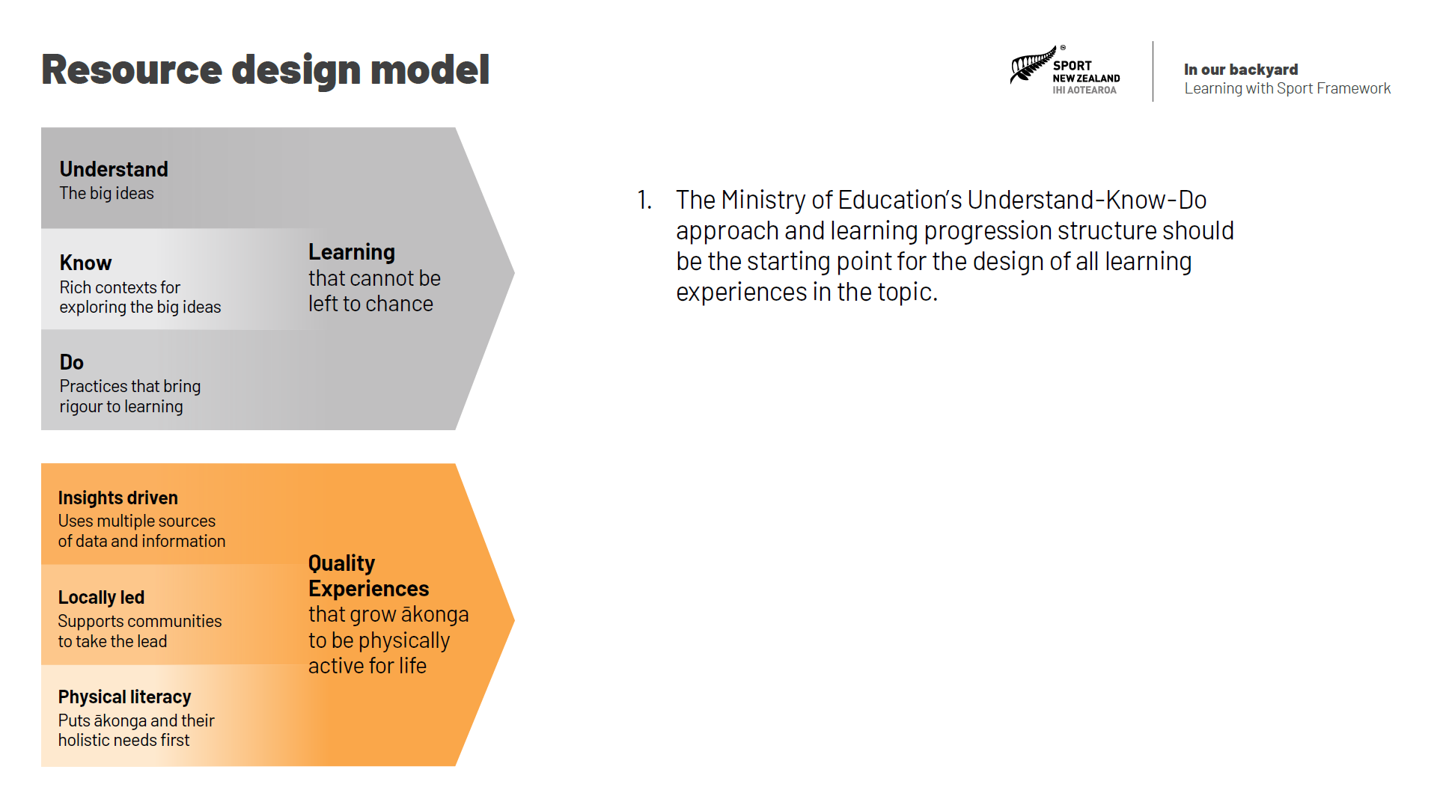
Notes:
One of the first tasks in reinventing how sports engage with schools and kura is to frame the learning journey that club-based learning experiences will contribute toward. ‘Learning with sport’ topics are best framed at the national level, and then contextualised and operationalised locally by Kāhui Ako, schools or kura, in partnership with the clubs at the community level. Some key things to consider are:
1. The Ministry of Education’s Understand-Know-Do approach and learning progression structure should be the starting point for the design of all learning experiences in the topic.

Slide 13
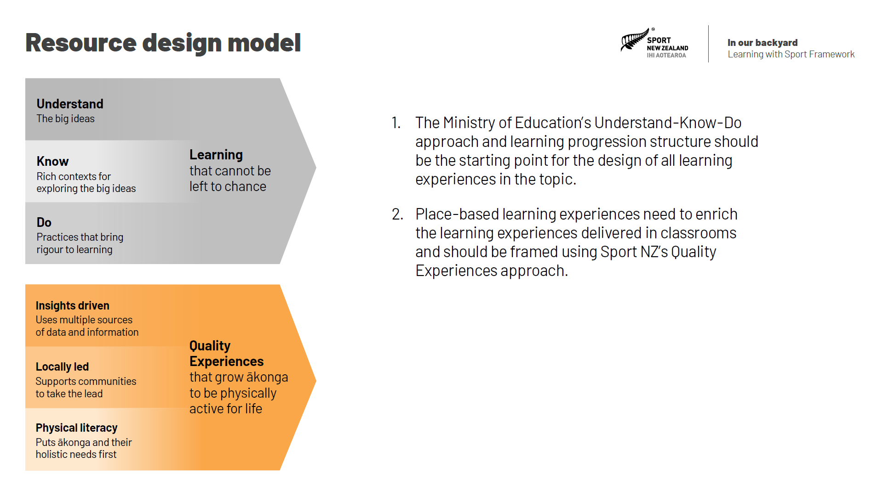
Notes:
2. Place-based learning experiences need to enrich the learning experiences delivered in classrooms and should be framed using Sport NZ’s Quality Experiences approach.

Slide 14
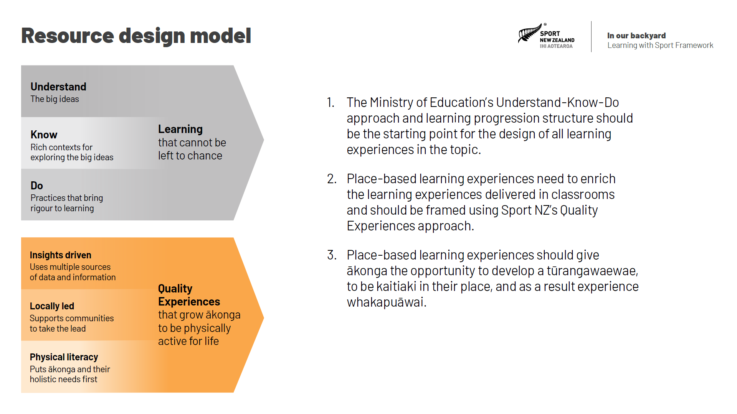
Notes:
3. Place-based learning experiences should give ākonga the opportunity to develop a tūrangawaewae, to be kaitiaki in their place, and as a result experience whakapuāwai.

Slide 15
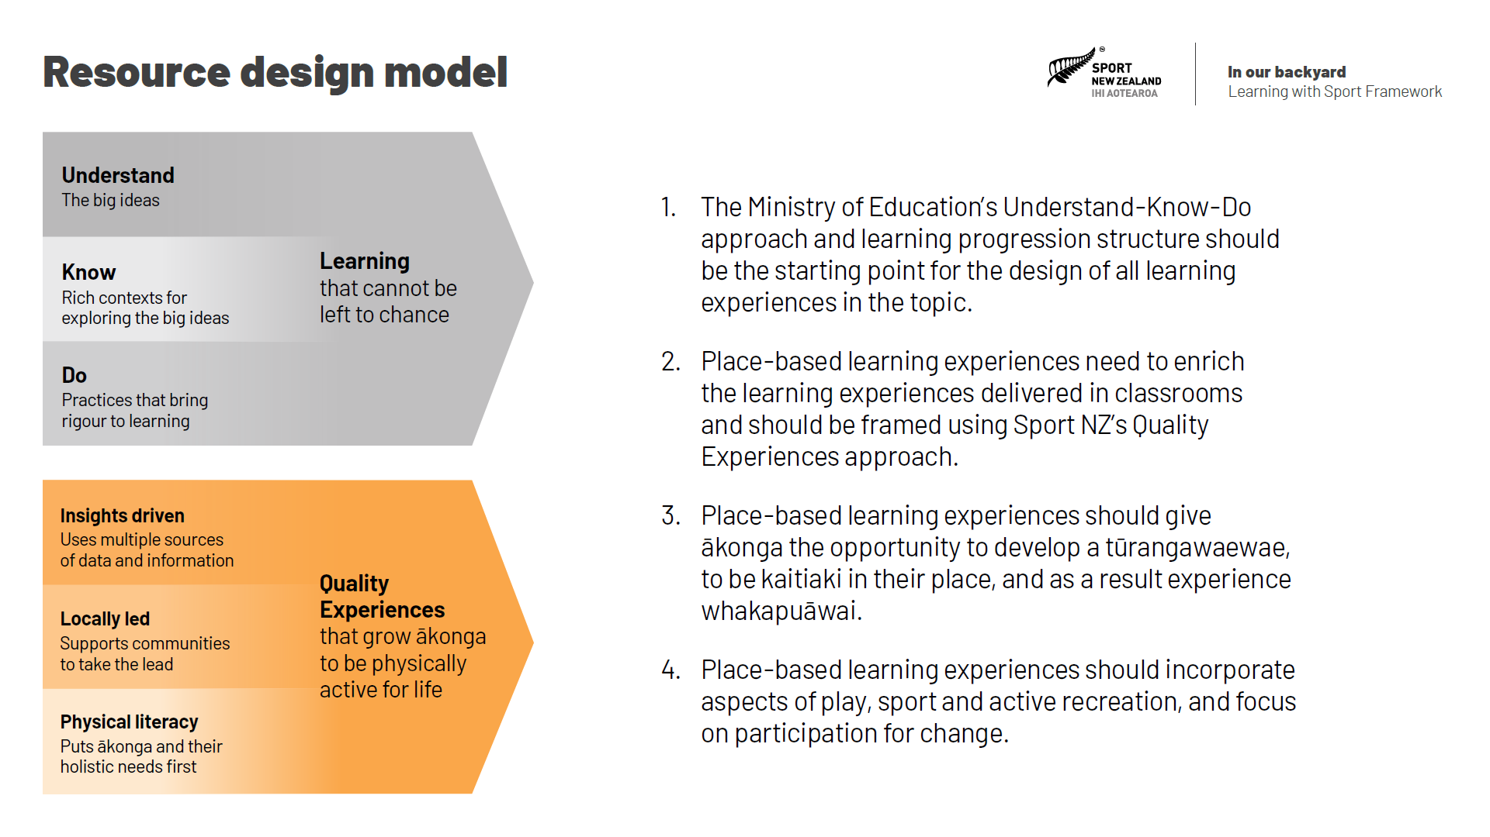
Notes:
4. Place-based learning experiences should incorporate aspects of play, sport and active recreation, and focus on participation for change.

Slide 16
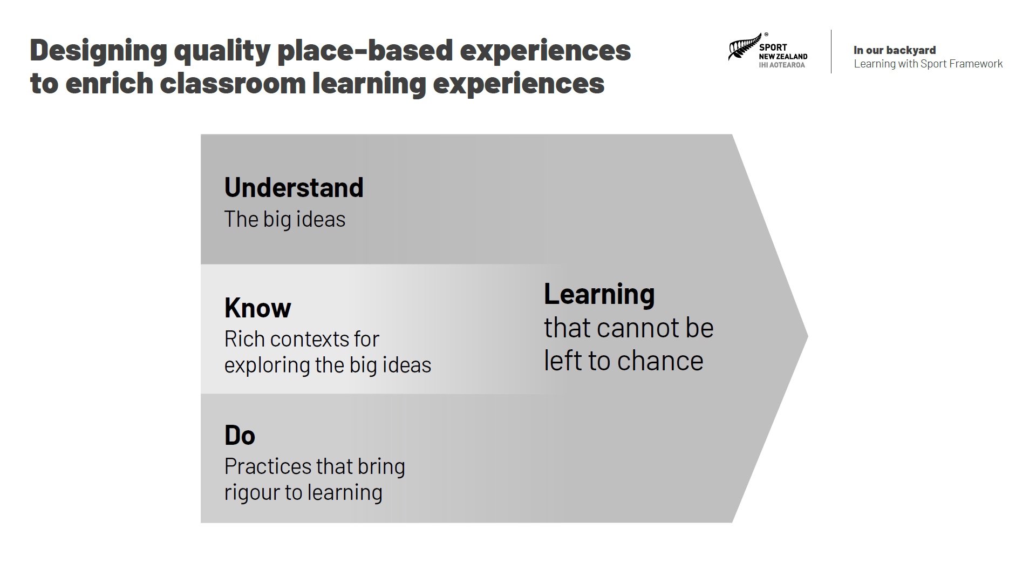
Notes:
To start the process of designing quality place-based experiences, sports need to unpack the knowledge, understandings and practices within the New Zealand Curriculum that relate to the learning journey they are creating. Sports need to ensure that the classroom and place-based learning experiences connect to the relevant big ideas from the New Zealand Curriculum. Sports need to base their learning journey within the rich contexts from the New Zealand Curriculum that relate to these big ideas. Sports also need to include the practices from the New Zealand Curriculum that will help ākonga bring rigour to their learning journey. And finally, sports need to ensure their experiences align to the intended progress outcomes for each phase of learning targeted within their learning journey.

Slide 17
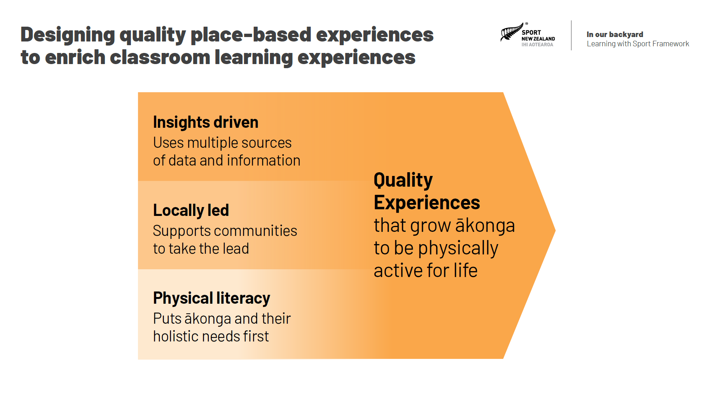
Notes:
We know from our Value of Sport research that, participation in play, active recreation, and sport support wellbeing. We know that to reap the full benefits of physical activity, people need quality experiences that increase their confidence, competence and motivation to value and choose active lifestyles. And we also know that it if we use evidence, community input, and a holistic approach then we are more likely to design better quality experiences for participants.
That is why we have Three Approaches; the insights approach, the locally led approach, and the physical literacy approach. Sports need to consider each of the three approaches when designing the quality place-based experiences that will enrich the classroom learning experiences in their learning journey.

Slide 18
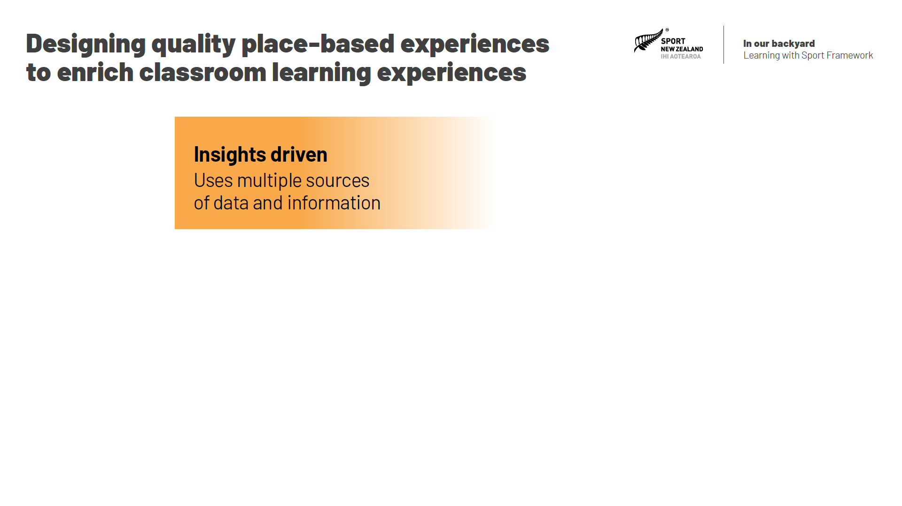
Notes:
The insights approach uses multiple sources of information to help understand the needs of participants and to improve decision-making. The insights approach draws on large data sets and tools to help develop a big picture view of different population groups. It uses voice of the participant and other insight gathering techniques to understand participants and their needs. And finally, the insights approach contextualises big picture data and participant voice by using local knowledge to shape quality experiences.

Slide 19
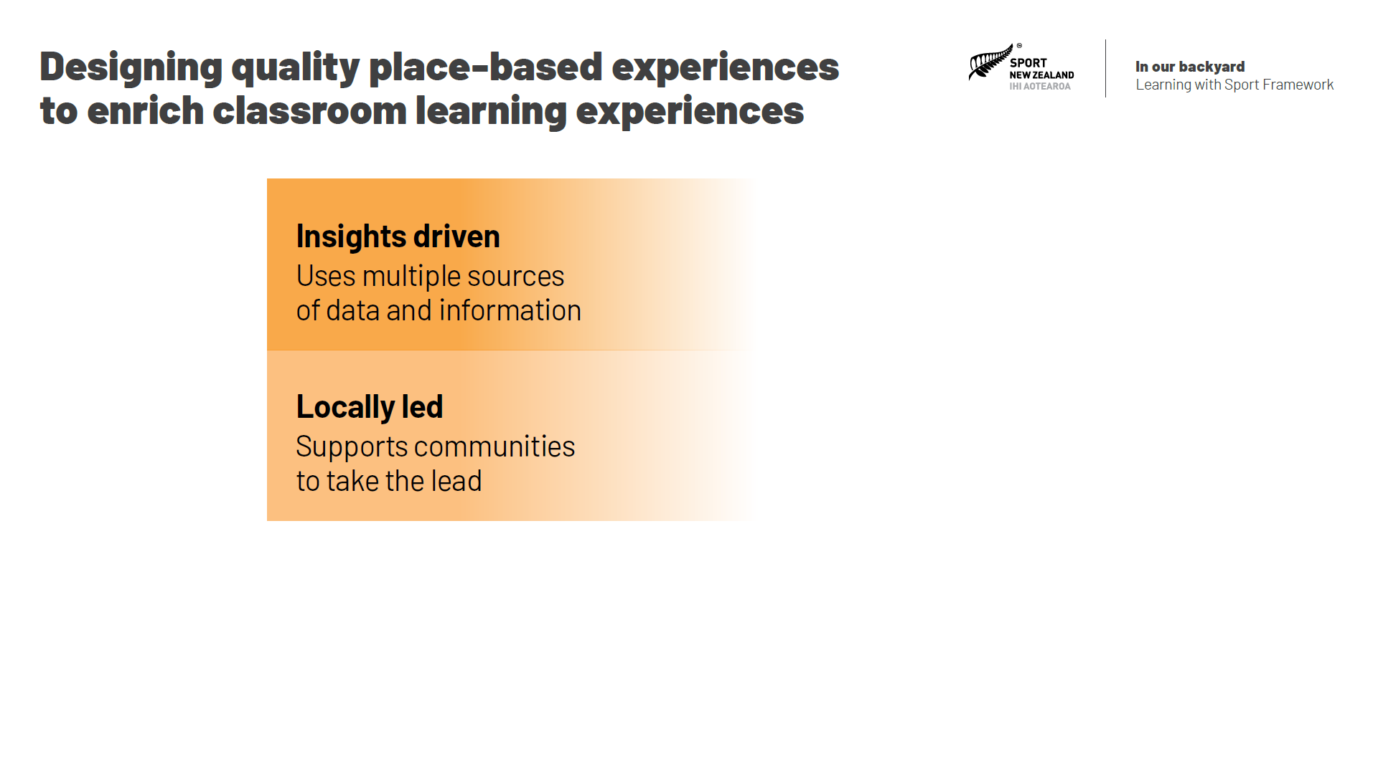
Notes:
The locally led approach acknowledges and seeks to learn from what is strong and positive. It’s about working in partnership towards goals, aspirations and opportunities identified by communities, organisations, schools, kura and population groups. By working together, solutions are co-created for positive change. An important part of the locally led approach is acknowledging that, as a sector, we do not have all the answers and that to create positive change, we must put the interests, desires and needs of communities first in order to identify where play, active recreation and sport can play a positive role.

Slide 20
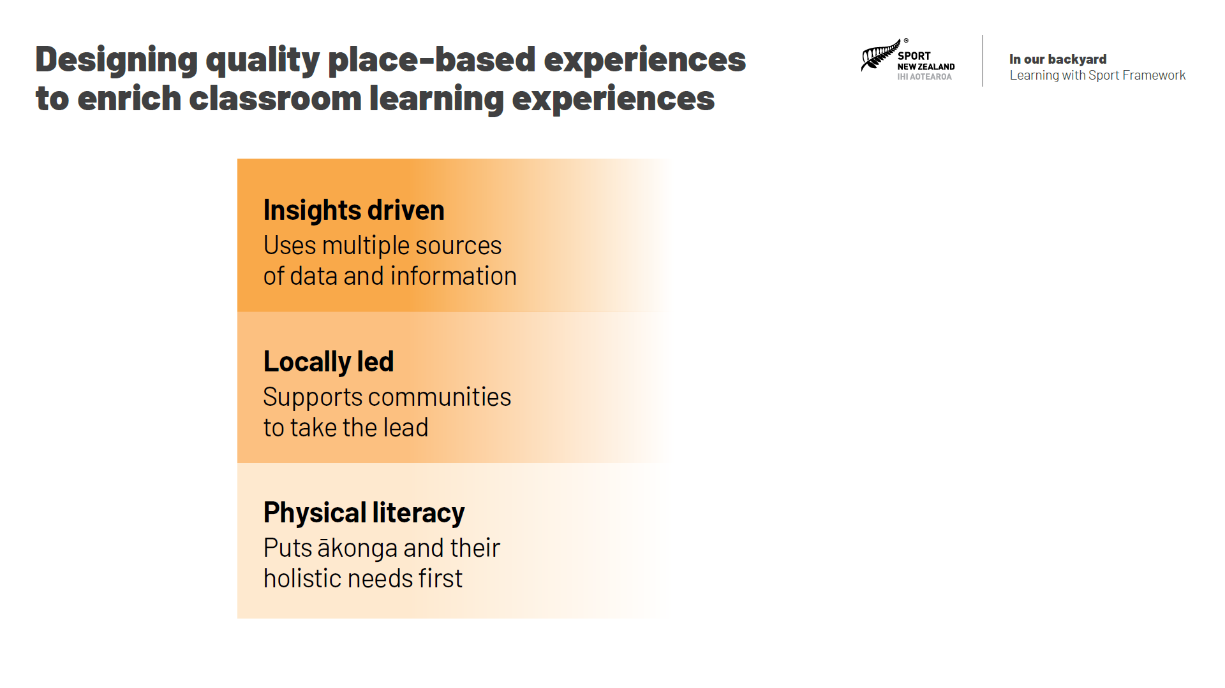
Notes:
A person’s physical literacy is a combination of their motivation, confidence and competence to be active, along with their knowledge and understanding of how being active contributes to their life. Everyone has their own unique physical literacy that contributes to their overall wellbeing. It affects how, why and if they participate in physical activity throughout their life. The physical literacy approach recognises that if you put the individual and their holistic needs first when designing experiences then there is a greater likelihood of them establishing a lifelong commitment to being active.

Slide 21
Notes:
When you weave together the three approaches then you are more likely to create quality place-based learning experiences that:
are rewarding, challenging, exciting and self-confirming,
focus on building more than skills, and emphasise motivation, confidence and the wider value of physical activity,
focus on ākonga taking ownership and responsibility for being active, and
impact positively on all elements of ākonga wellbeing.

Slide 22
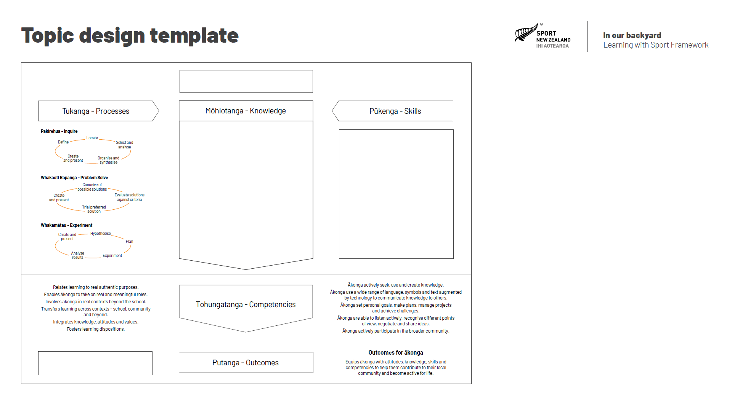
Notes:
We have developed a template to help sports frame the learning journey that place-based learning experiences will contribute toward. As curriculum design is not core business for national sporting organisations, the aim of the template is to simplify the process of describing the learning journey while ensuring it includes key elements that matter to schools and kura.
There are four key areas for sports to summarise in the template.

Slide 23
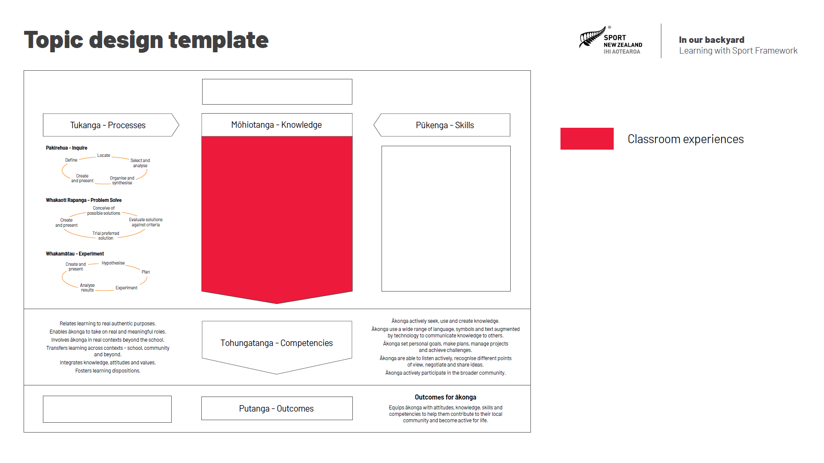
Notes:
The first is the classroom learning experiences that ākonga will participate in.

Slide 24
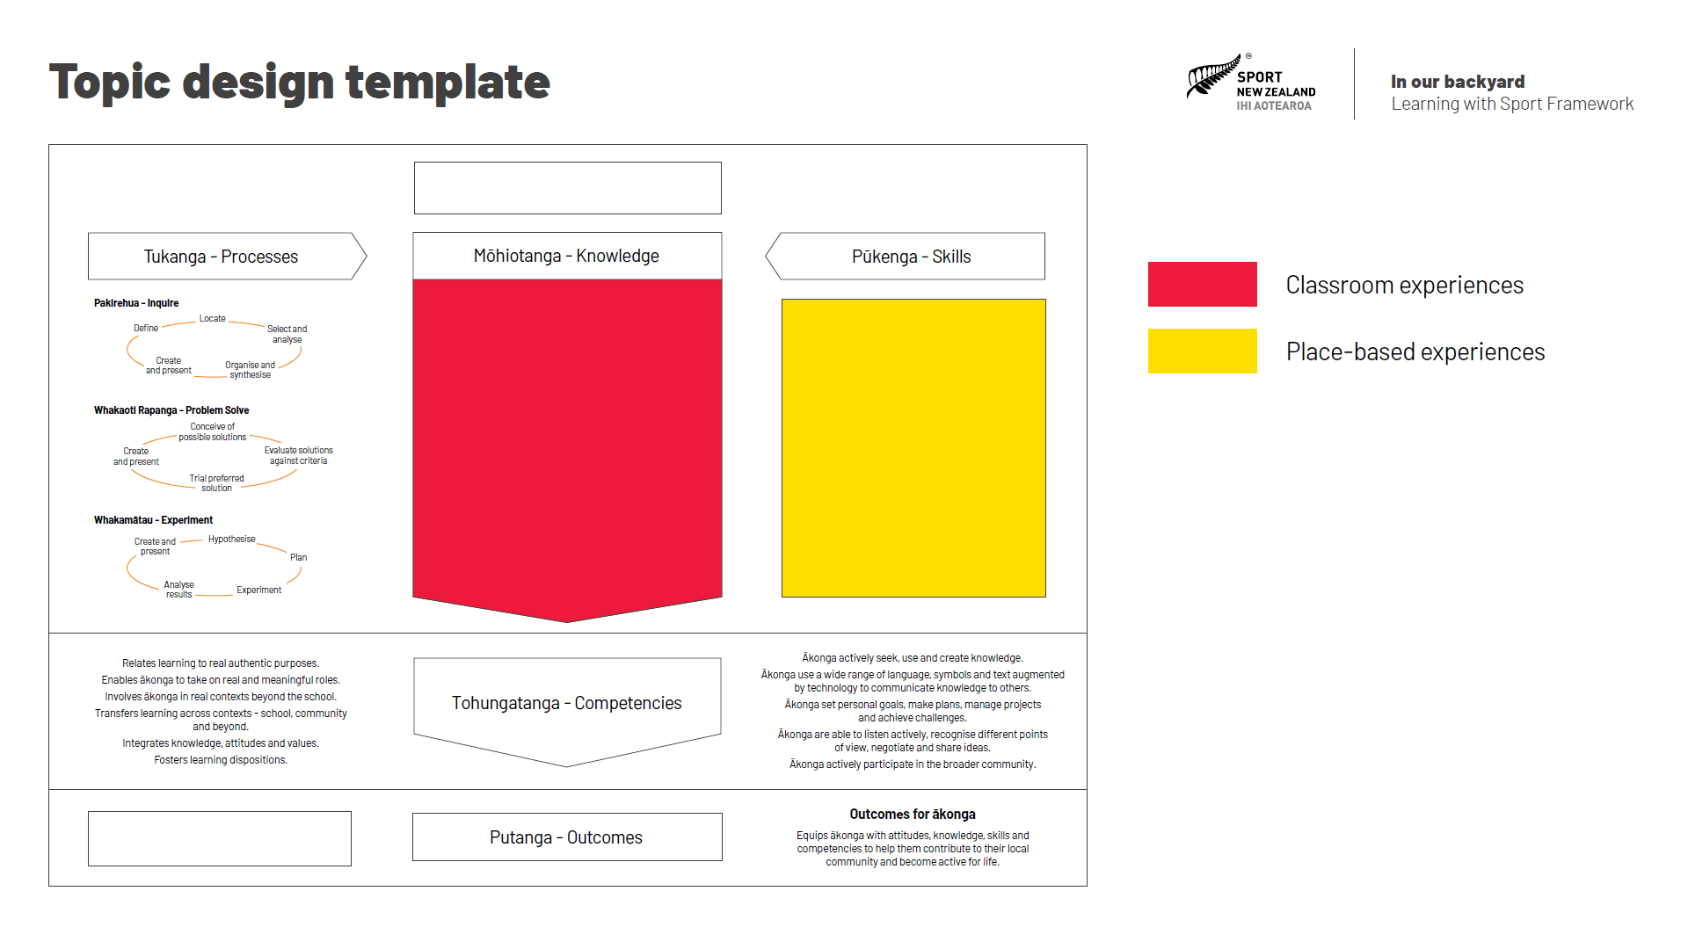
Notes:
The second is the place-based learning experiences that ākonga will participate in.

Slide 25
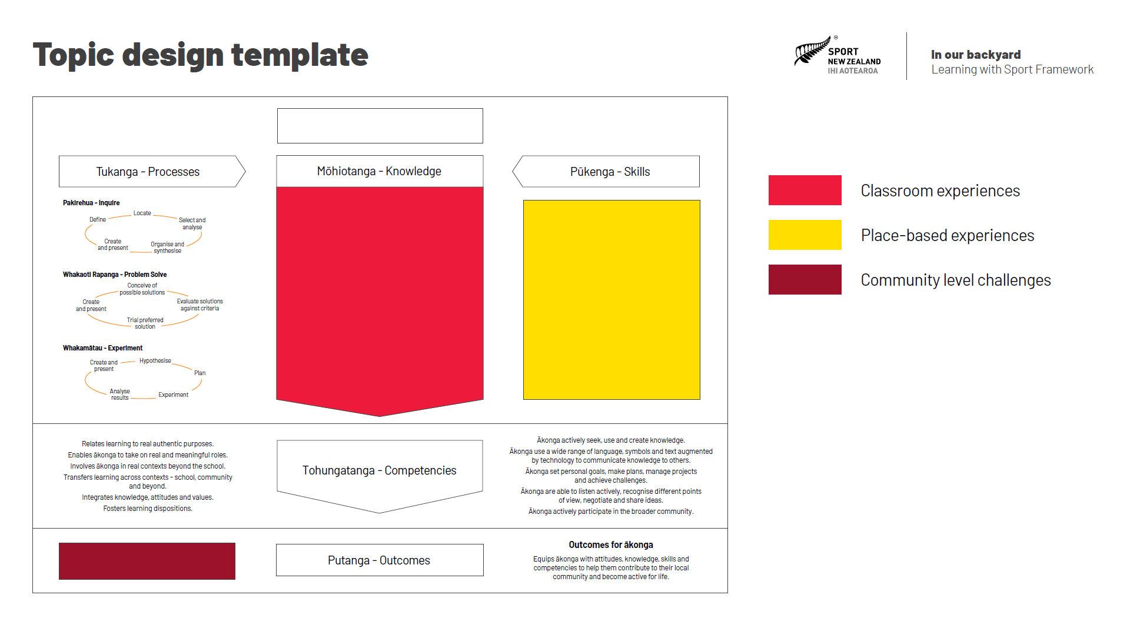
Notes:
The third is the challenge for society that ākonga will address during their learning journey.

Slide 26
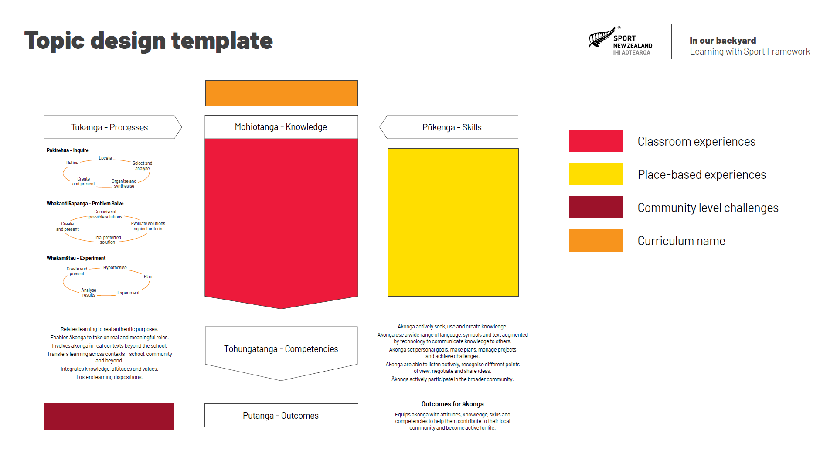
Notes:
And finally, the topic is given a name.

Slide 27
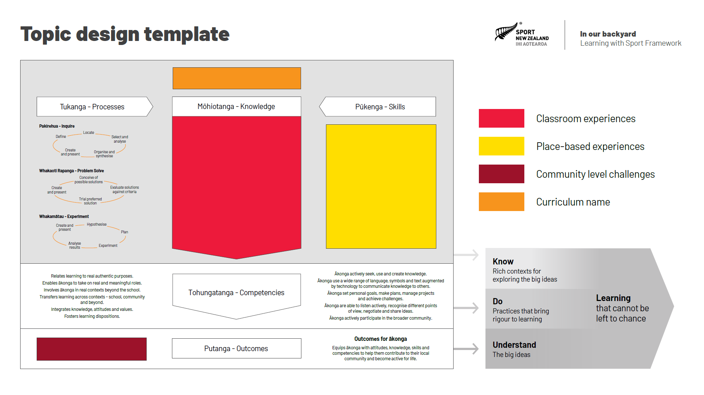
Notes:
The classroom learning experiences combined with the place-based learning experiences provide the means for ākonga to explore the big ideas and contexts that are drawn from the New Zealand Curriculum and are associated with the topic.

Slide 28
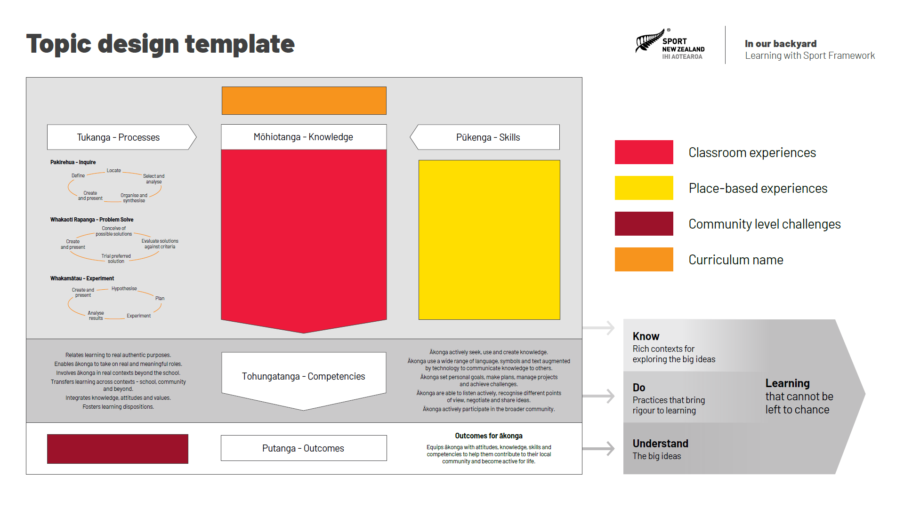
Notes:
The use of inquiry, problem solving and experimental processes, to address challenges in contexts beyond the classroom, in combination with the practices from the New Zealand Curriculum, brings rigour to the learning journey.

Slide 29
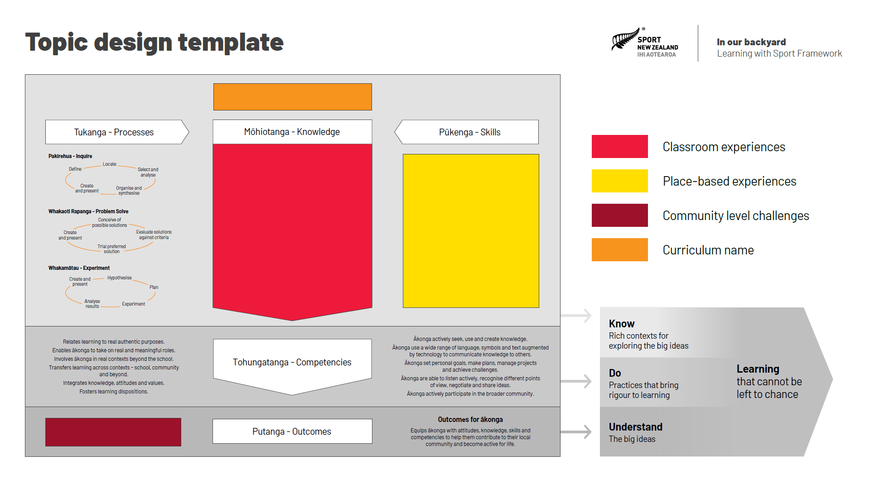
Notes:
And the focus on helping to solve challenges for society enables ākonga to use and apply their learning, so that their learning journey is purposeful and contextualised, and helps them understand the big ideas from the New Zealand Curriculum. This understanding, when combined with the knowledge gained and the practices used during the learning journey, should support ākonga to experience the learning that our education system has determined cannot be left to chance.

Slide 30
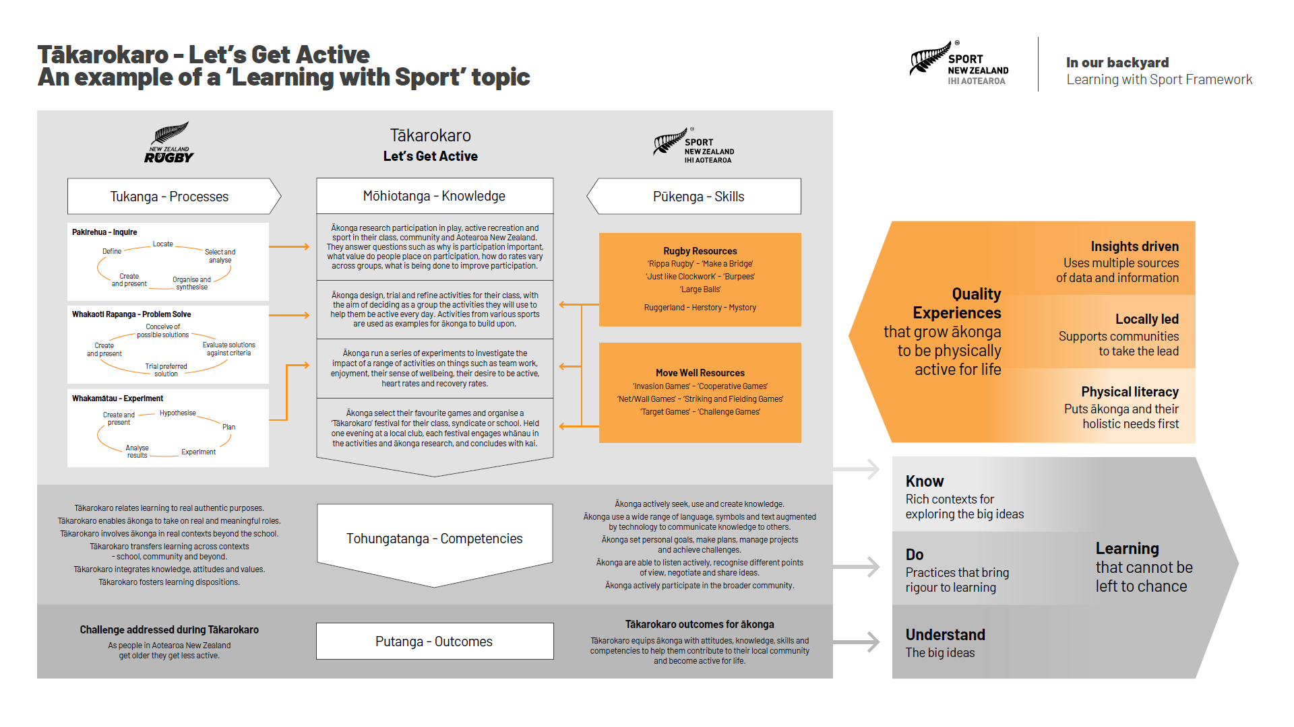
Notes:
At the heart of every ‘learning with sport’ topic are five key things.

Slide 31
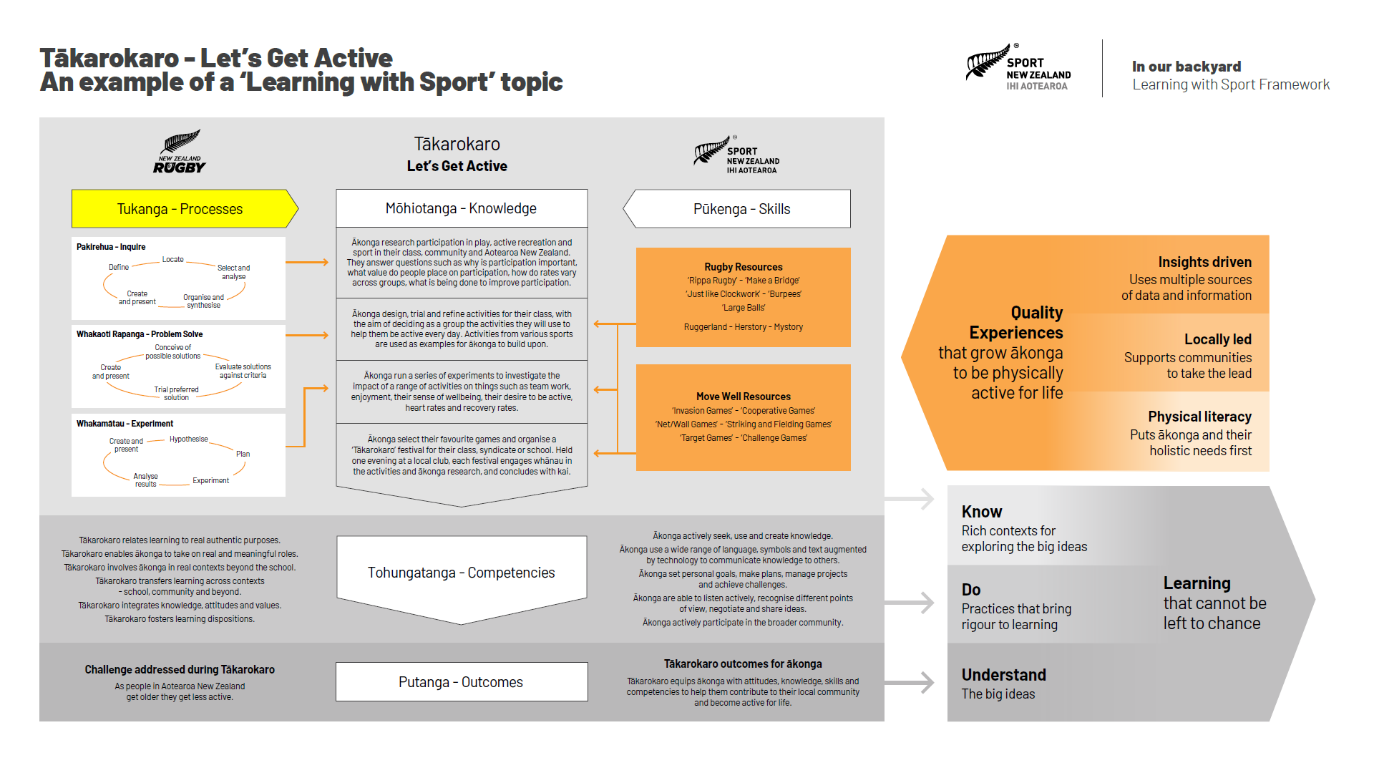
Notes:
Ākonga use tukanga or processes

Slide 32
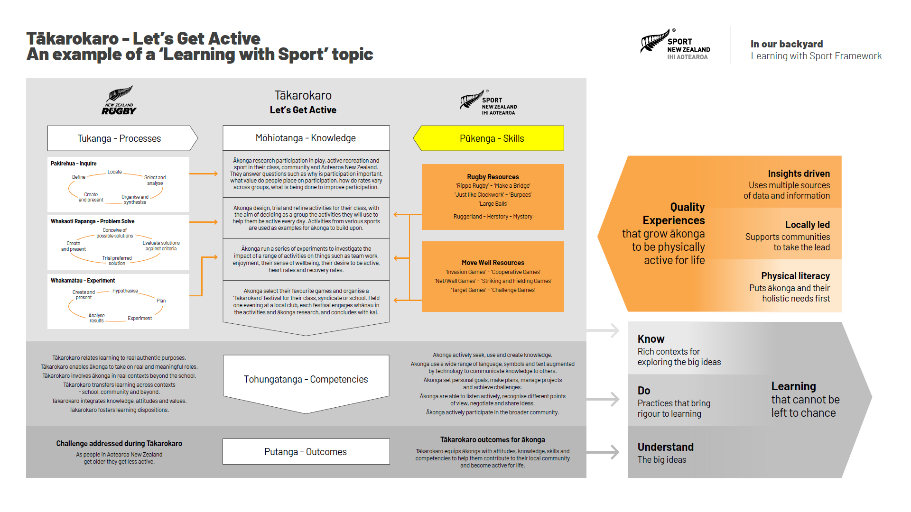
Notes:
combined with pūkenga or skills

Slide 33
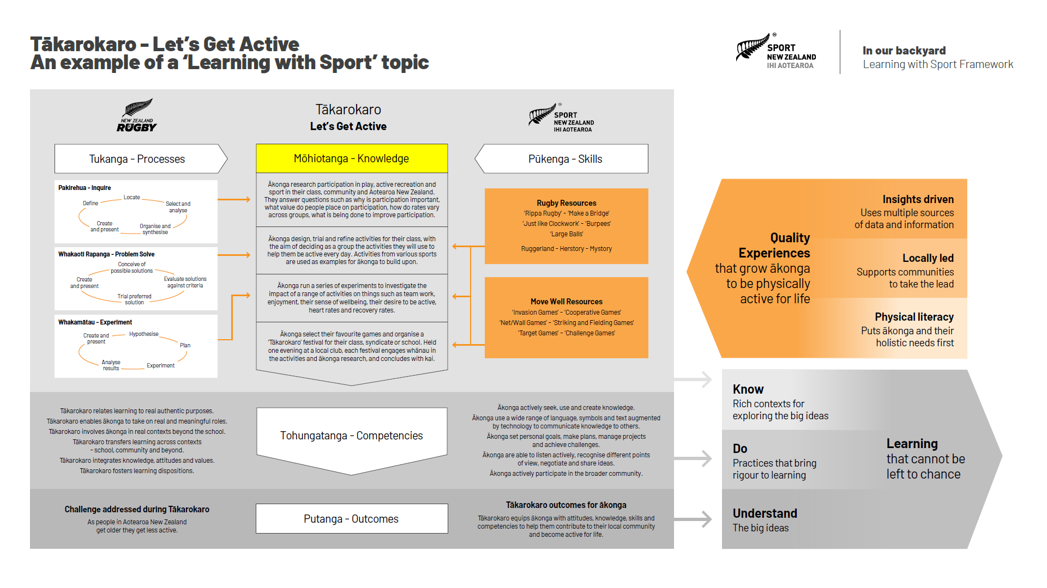
Notes:
to acquire mōhiotanga or knowledge,

Slide 34
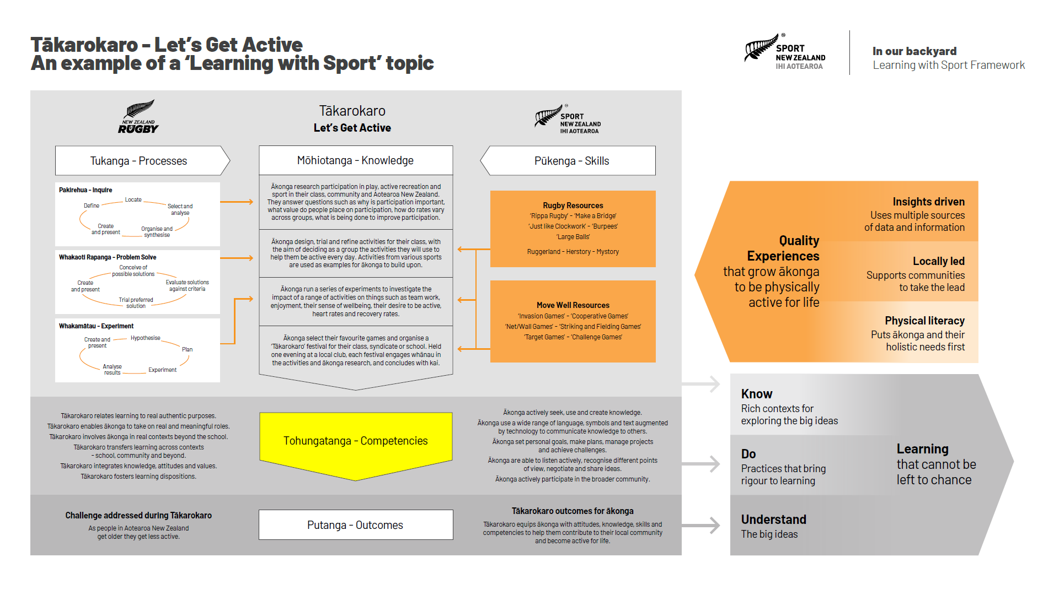
Notes:
which they integrate with tohungatanga or competencies

Slide 35
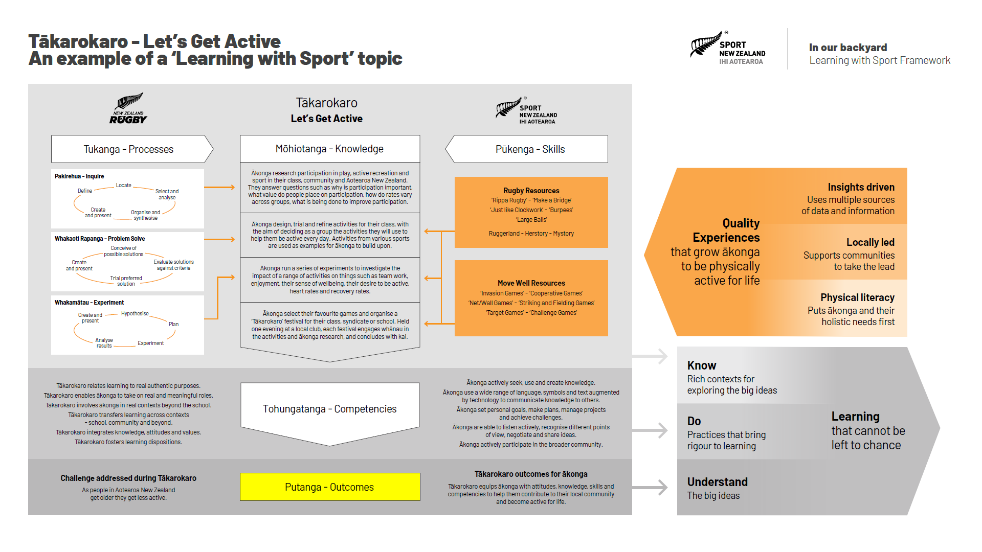
Notes:
to produce positive putanga or outcomes for their community.

Slide 36
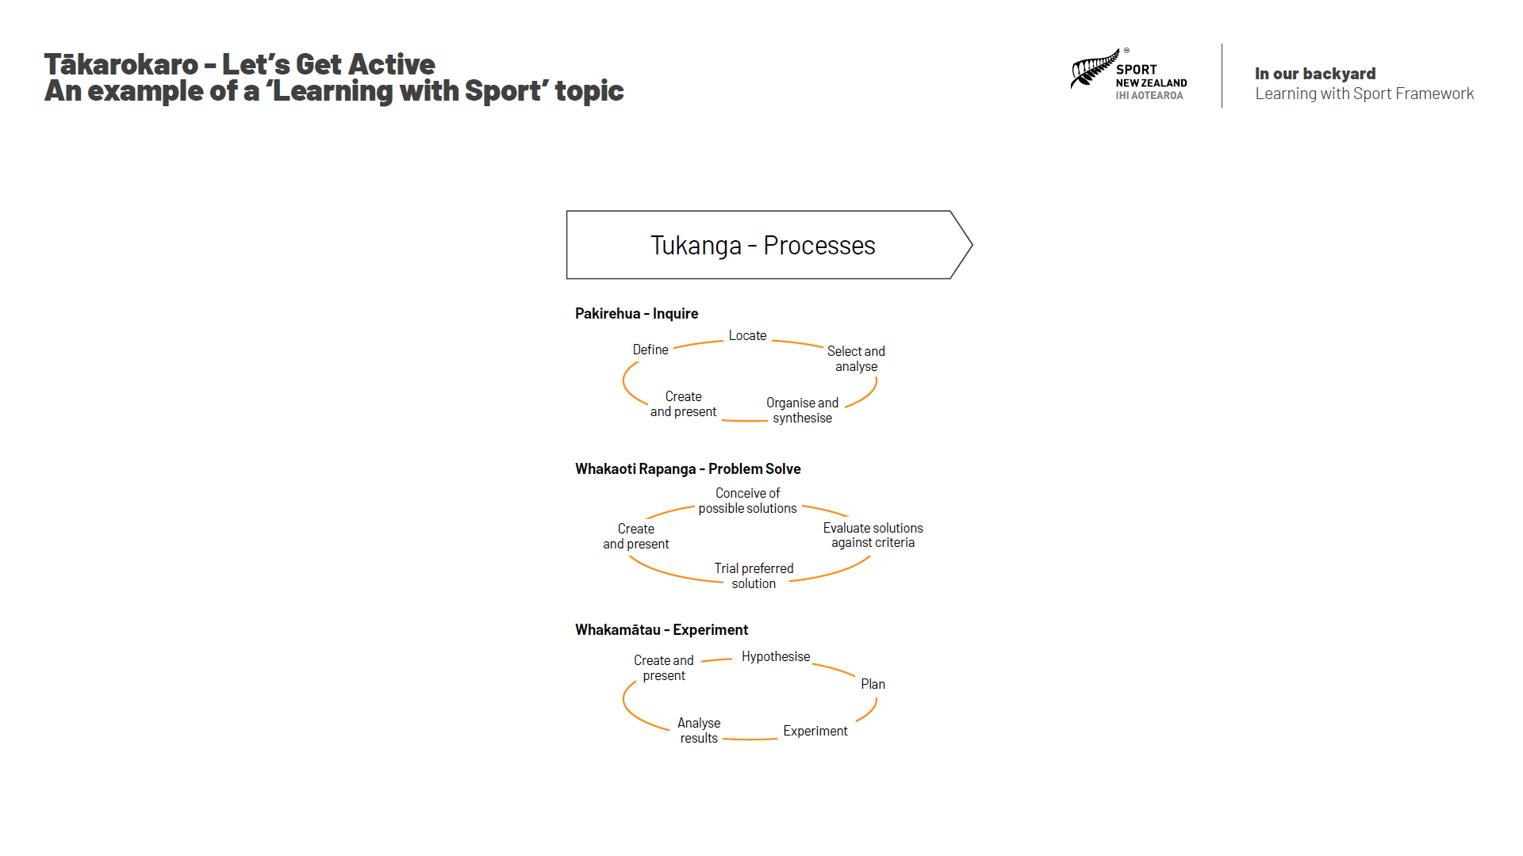
Notes:
Each ‘learning with sport’ topic combines the use of inquiry, problem solving and experimental processes as tools for ākonga to use to acquire mohiotanga or knowledge. These processes are consistent across all ‘learning with sport’ topics, with ākonga becoming more sophisticated in their use as they move through the progression phases in the education system.

Slide 37
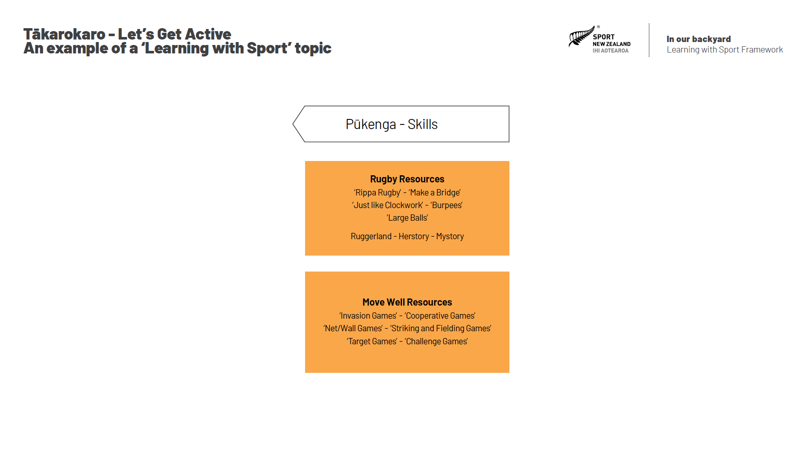
Notes:
Each ‘learning with sport’ topic emphasises a set of pūkenga or skills that come from the sport which has created it. In Tākarokaro these skills come from rugby and focus on the ways in which rugby clubs help to keep people active.

Slide 38
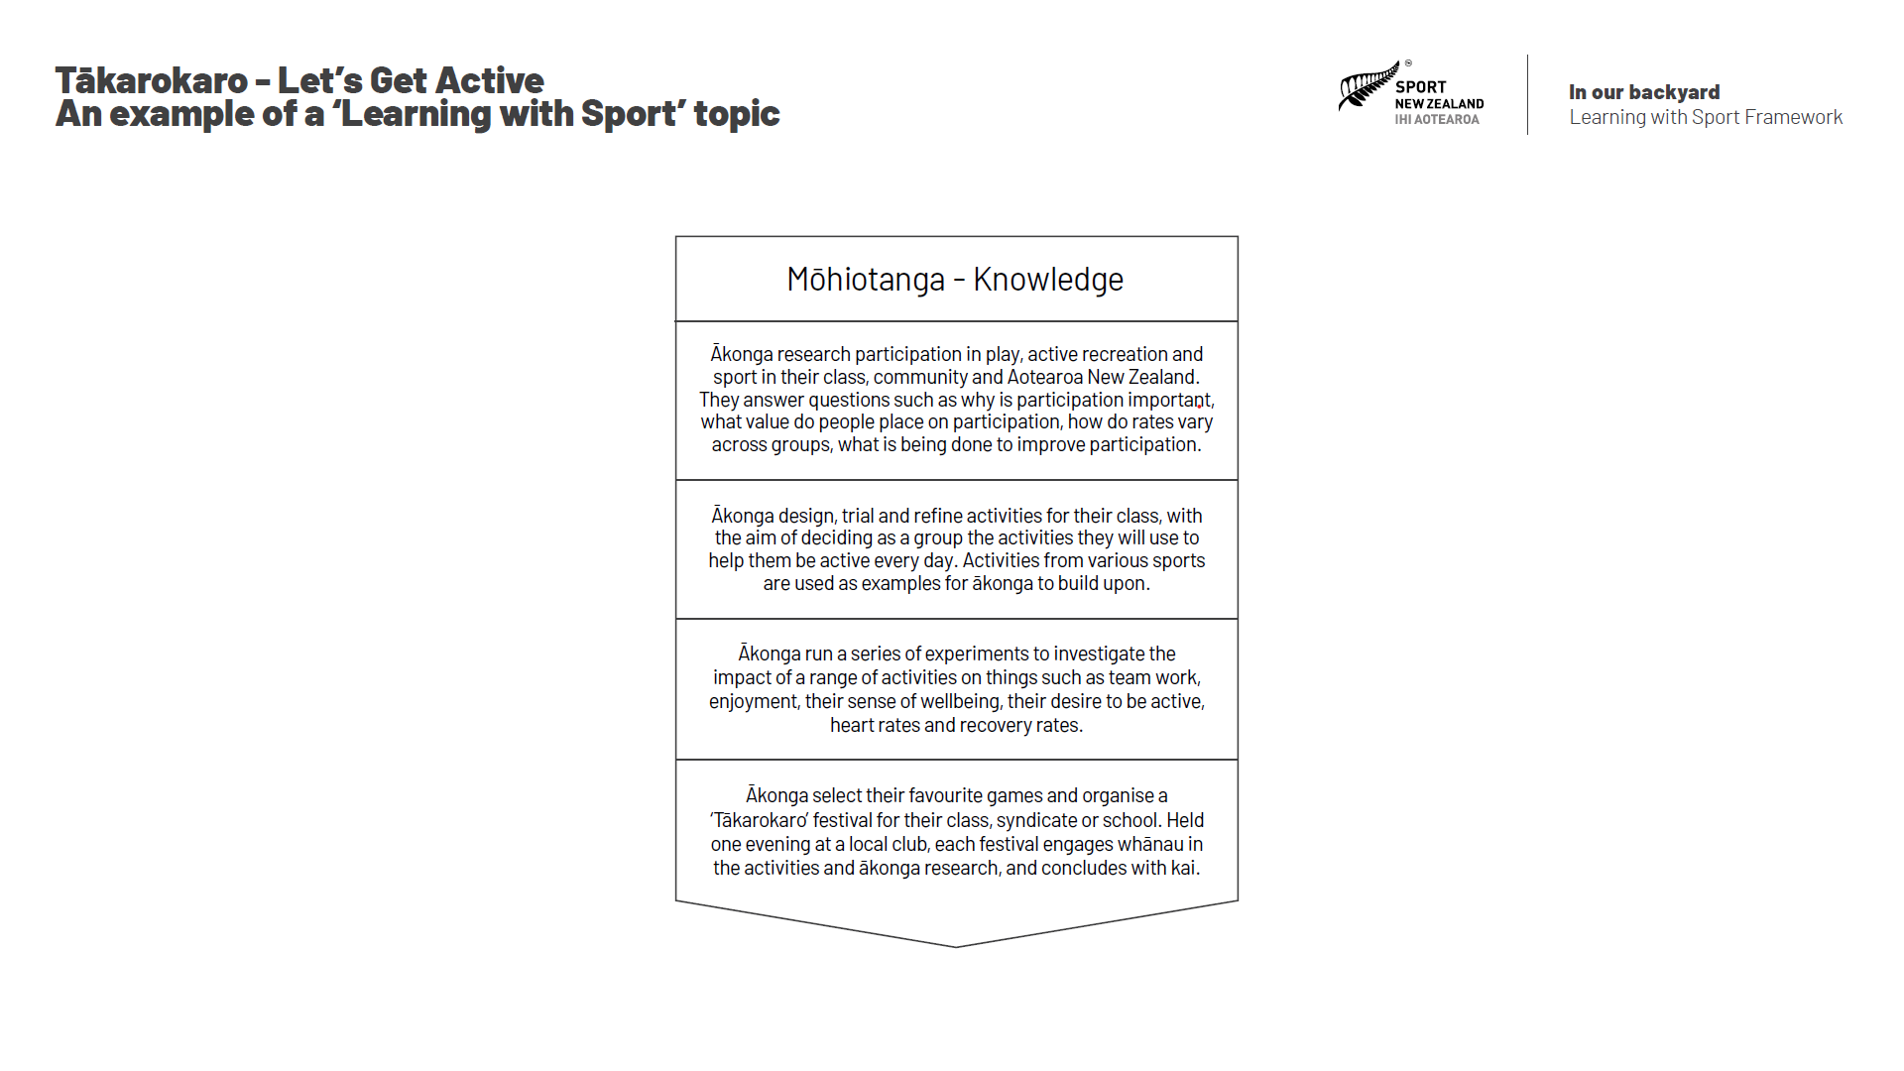
Notes:
Each ‘learning with sport’ topic provides a summary of the learning experiences that ākonga will have during their learning journey. In theTākarokaro example, ākonga research participation in play, active recreation and sport in their class, community and Aotearoa New Zealand. They use the problem-solving process to design, trial and refine activities for their class. They then run a series of experiments to investigate the impact of their activities. And finally, they organise a ‘Tākarokaro’ festival at a local club to share their research and activities with whānau.

Slide 39
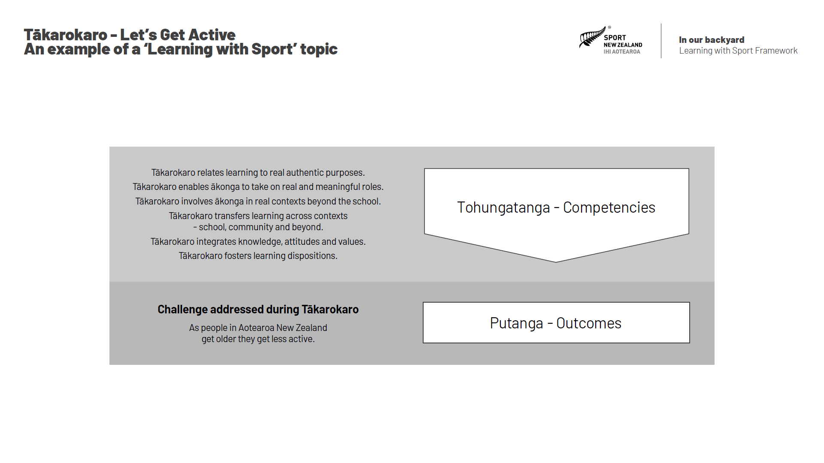
Notes:
Each ‘learning with sport’ topic relates learning to real authentic purposes, enables ākonga to take on real and meaningful roles, involves them in real contexts beyond the school, transfers learning across contexts – including school, community & beyond, integrates knowledge, attitudes and values, and fosters the development of learning dispositions, while focusing on a specific challenge faced by society, which in the Tākarokaro example is the fact that as people in Aotearoa New Zealand get older they get less active.

Slide 40
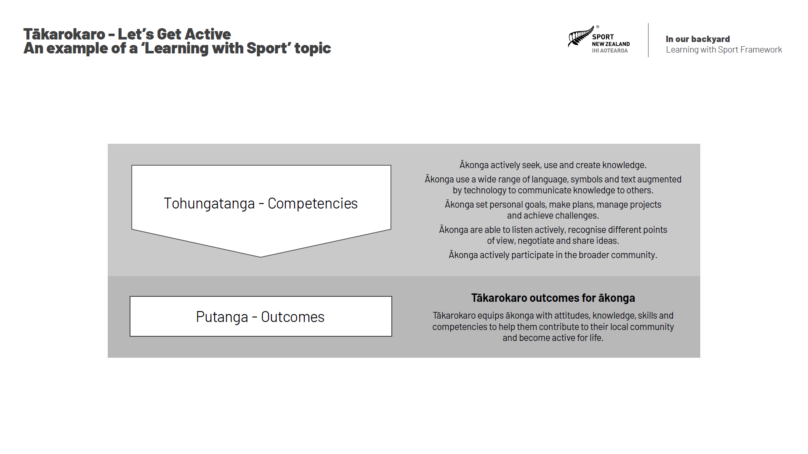
Notes:
And finally, all ‘learning with sport’ topics aim to equip ākonga with the attitudes, knowledge, skills and competencies to help them contribute to their local community and become active for life.

Slide 41


Slide 42

Thank You

