Slide 1

Workforce Squad & Host Team
1
Notes:
Welcome and thank you for your commitment and enthusiasm. It is a pleasure to have you on board. You bring a wealth of experience and knowledge. It is important that we provide a Rugby World Cup service that is nationally consistent.

Slide 2
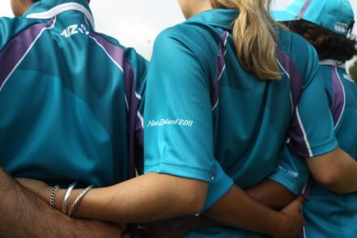

Welcome!
2
Notes:
Why are we here - define roles and responsibilities at tournament time , provide information to you and acknowledge the huge contribution you will make to this tournament
Purpose of the session – provide information and training , answer your questions , address any concerns.
What we will achieve by the end-
you will have the answers to your questions
more information on your duties and responsibilities at tournament time
Be really excited about your contribution to this event
Housekeeping – toilets , evacuations rules

Slide 3

Our Focus Today - Agenda
Welcome and overview
Team 2011 and Workforce Squad
Defining success for the Workforce Squad
A day in the life of the Workforce Squad
He Ringa Manaaki
Regional activities
Wrap-up and Next steps
Notes:
3
Agenda – How we will go about the session

Slide 4
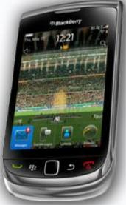

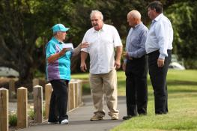

Making the most of our
time together
Notes:
4
How we’re going to work. Ground rules
What we put in is what we get out – the discussion we have at our table/s is really important
Timing is important. For each activity we will give you times, and we will have a break at XXXXX. We should finish by XXXX
- You have space in your training manual for notes. Be sure to write down any insights or questions!
- We will give you time for checking messages. Please turn your phones of.

Slide 5

Who’s Here?
Notes:
Who’s here activity – This exercise breaks the ice and allows attendees to identify other volunteers and the contributions they can make from past experience.
Could be human bingo
Table discussion about previous experience in your FA

Slide 6
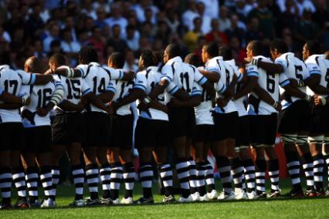
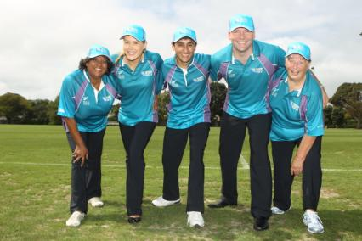
Who’s In The Line-up - Team 2011
6
Notes:
Talking points include:
Part of a bigger team making this amazing Tournament happen – Team 2011 ‘face of the Tournament’.
Introduce theme of wider workforce and stadium of 4 million
Delivering an operationally successful Tournament.
Customer excellence to an estimated 85, 000 visitors from over 127 countries.
An opportunity to show case our national rugby passion, our beautiful country, landscape, people and culture to the world.
6000+ people
The ‘face’ of the Tournament
A group like no other ever seen in New Zealand
Critical to the delivery of Rugby World Cup 2011!

Slide 7
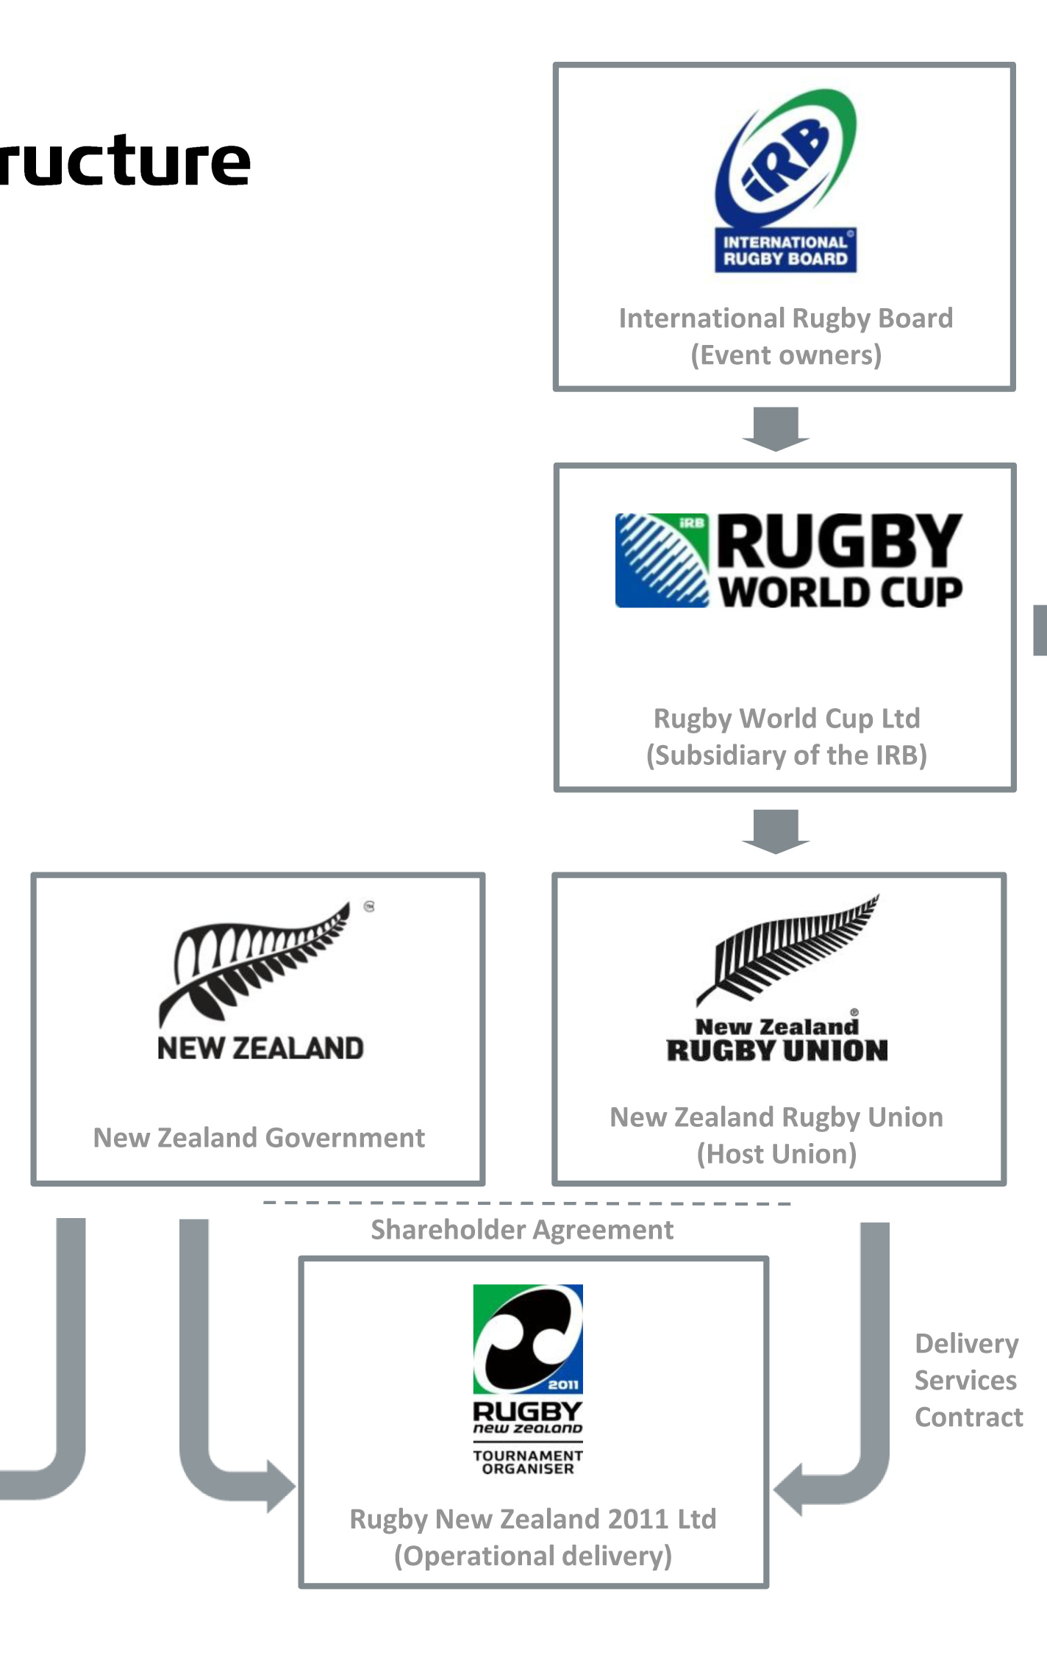
Team 2011
7
Notes:
Overview of RWC 2011
IRB & RWC - structure layout (very quick reminder after online orientation)
Group discussion: What is the main function of each group?
Finish with Team 2011 – the face of the Tournament!
Provide overview of Team 2011 demographics
Quantity, spread around NZ, enthusiasm captured like no other event ever staged in New Zealand
Share two-three quotes from those who were the first to accept their role

Slide 8
Understanding Our Functional Areas
At your tables, match the Functional Area names with the appropriate description.
Be as fast as you can!
8
Notes:
CARD SORT MATCH THE PHRASE TO THE FA
Explain that we may be asked a variety of questions from visitors and we may be required to direct them to other members of the wider Team2011.
Key point : Everyone needs to take ownership and provide a great customer experience “ open hands & hosting “ by understanding other areas roles at tournament time you will be able to assist or direct someone to key areas.

Slide 9
Workforce Squad Structure
Notes:
Take the group briefly through the Workforce Squad

Slide 10
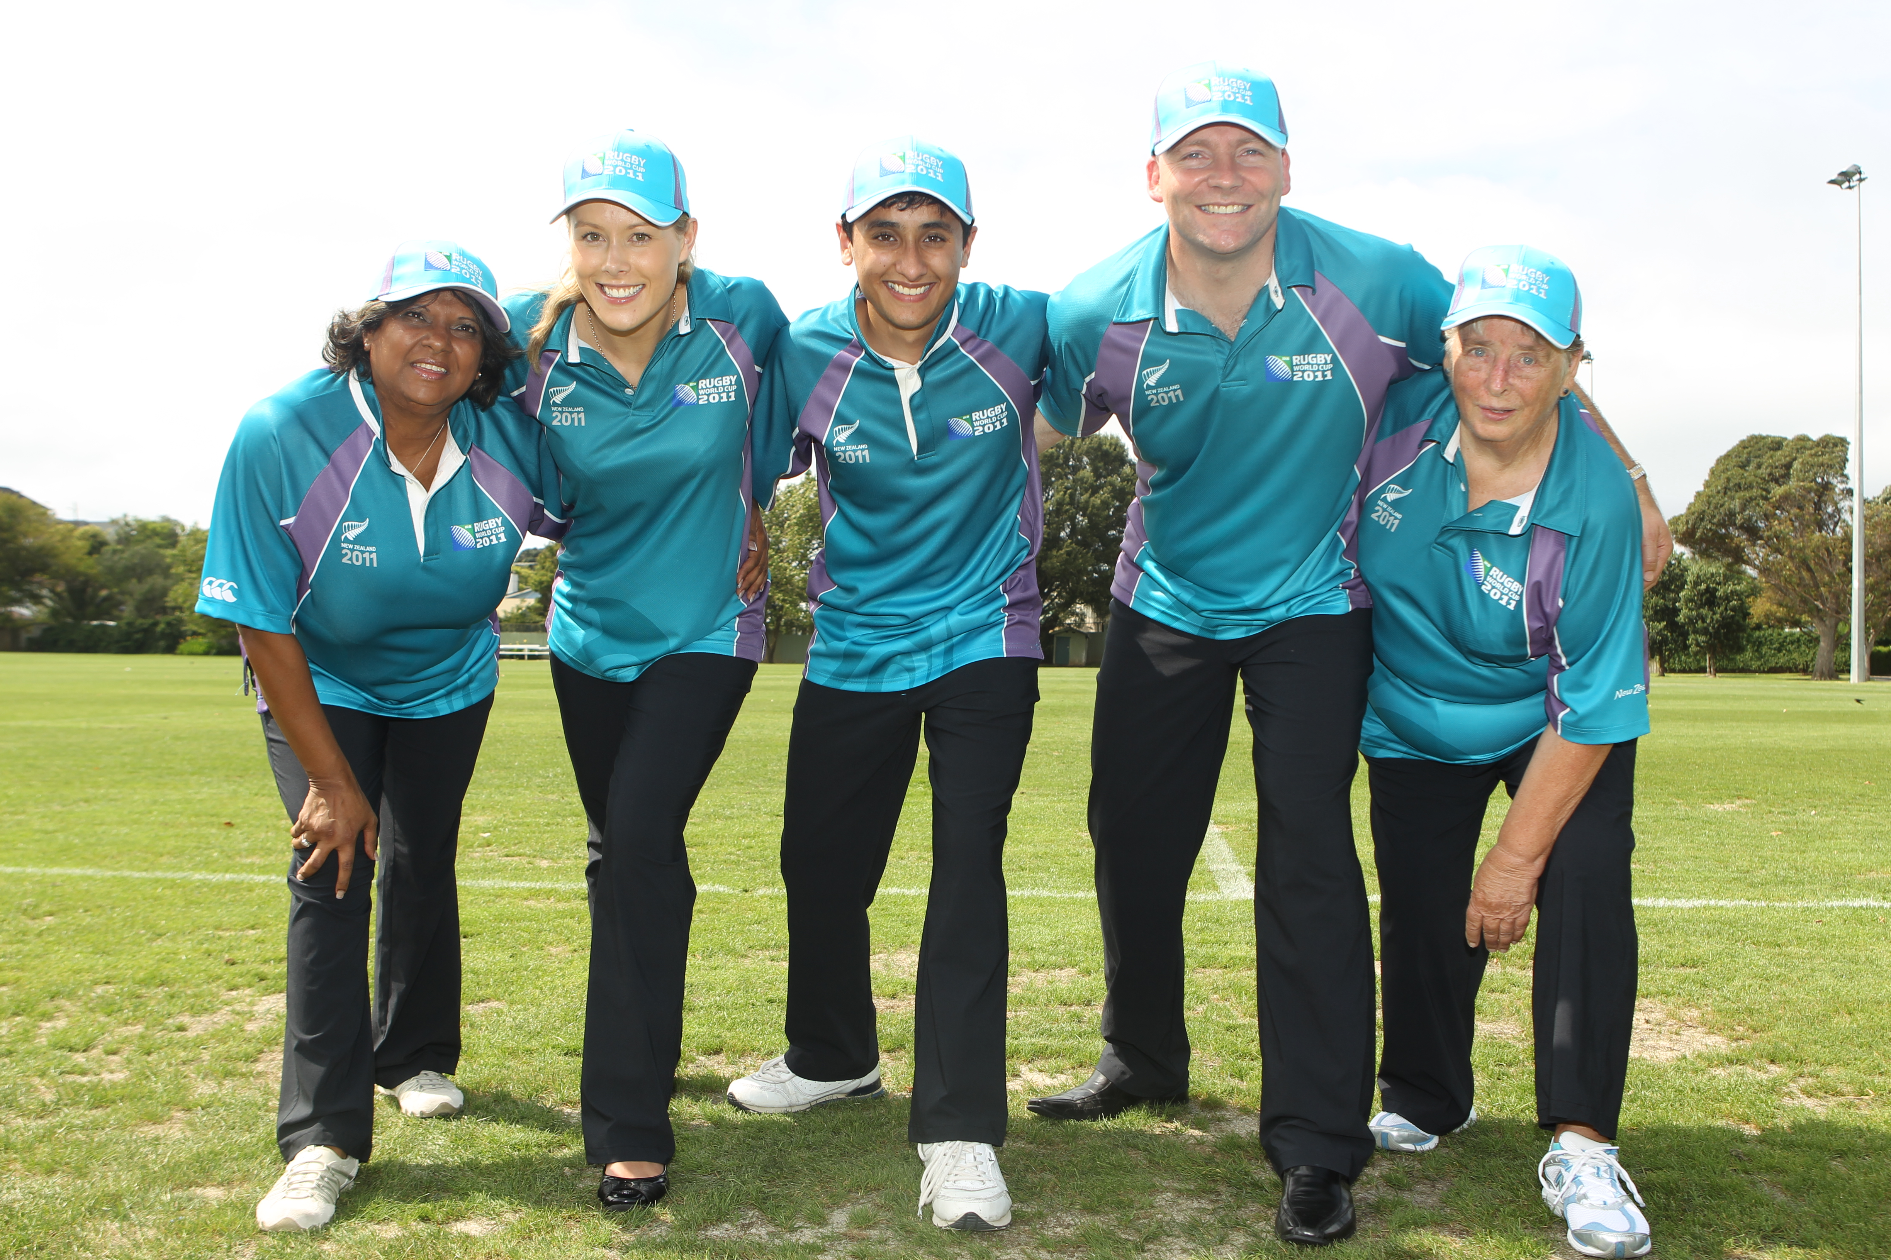
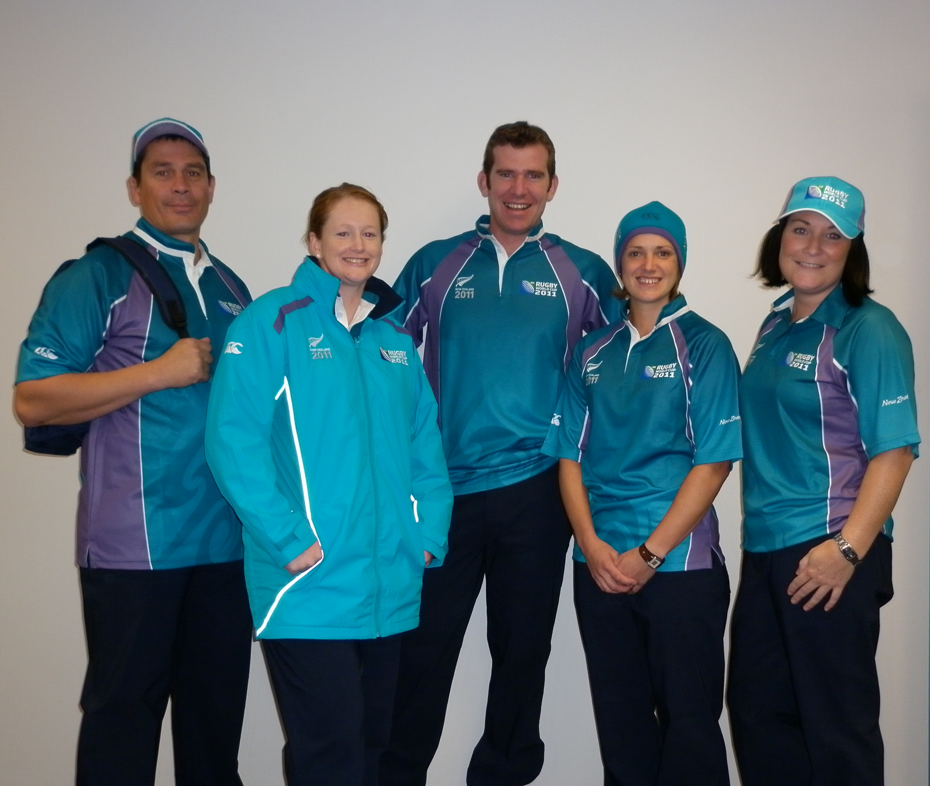
The Workforce Squad
10
Notes:
The Workforce Squad is a support function; the ‘force behind the scrum’
They promote operational efficiency and effectiveness
They ensure that each and every member of Team 2011 enjoys their experience at Rugby World Cup 2011.
The Workforce Squad look after the well being of Team 2011
The team efficiently manages the Workforce check-in and break areas, assist with scheduling, produce venue specific and Tournament communication and ensure the proper care and treatment of all Team 2011 representatives.

Slide 11

What We’re Aiming For - activity
Individually, write everything you think ‘success is’ for the Workforce Squad
One word/phrase per post it note
Create as many post its as you can!
You have 90 seconds!
11
Notes:
Ask volunteers –What will success look like for the Workforce Squad at tournament time ?
After 2-3 minutes, get each table to stick all their post it notes on a wall, then as groups (or just one if a small group)
they discuss common themes emerging
Their task is to ‘cluster’ all their post it notes into themes, then agree a sentence that uses the words/themes

Slide 12
Workforce Squad Roles and Responsibilities
At your tables, match the Workforce Squad roles with the descriptions.
Discuss how they’re different, and how we rely on all roles for a seamless experience.
12
Notes:
Card sort
Everyone will have a role to play ...
Sometimes it will be dependent on workloads .
However we all need to understand the roles and the dependencies and work together as a team

Slide 13
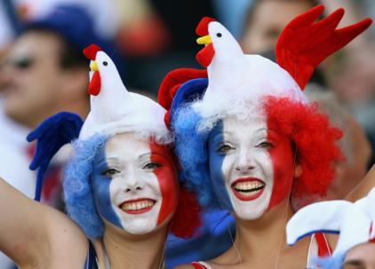

BREAK
13

Slide 14
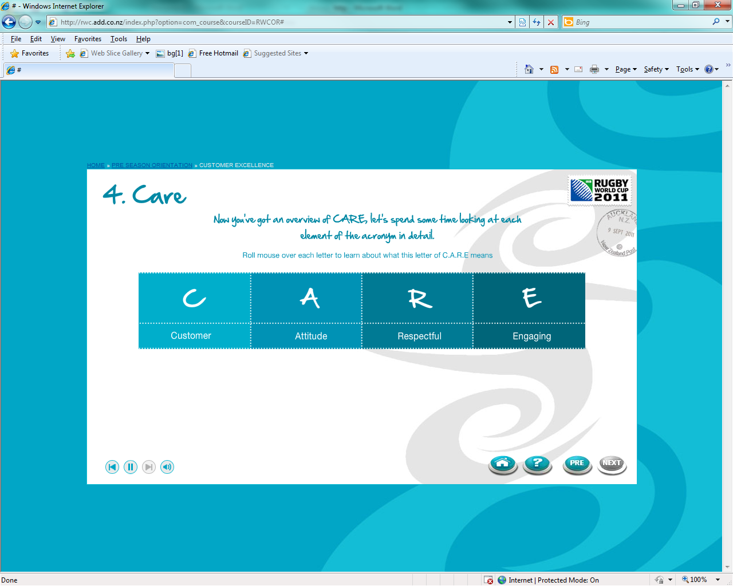
C.A.R.E
14
Notes:
Click to access the CARE acronym and twice for the words for each letter.

Slide 15
A day in the life of the Workforce Squad
Split into teams according to your role
Create a skit or presentation that illustrates a typical day in the life outlining your key roles and responsibilities
You have 15 minutes to prepare a 2 minute presentation
15
Notes:
Using the functional area section of their training manual create either a skit or presentation that illustrates a typical day in the life outlining their key roles and responsibilities. Encourage each team to be as creative as they can. Allow them 15 minutes to prepare a 2 minute presentation.
Debrief the session to ensure that key information for both roles has been covered.

Slide 16
Work Operations – Group Discussion
Team 2011 Check-in
Workforce Catering
Workforce Scheduling Support
Workforce Recognition
Team 2011 Communication
Workforce Incident Management
16
Notes:
Lead a group discussion that outlines the purpose and key tasks for Team 2011 Check-in Ask the group if anyone knows what they purpose of Team 2011 Check-in is?

Slide 17
Work Operations – Group Discussion
Team 2011 Check-in - Purpose
The Workforce Squad will check in all Team 2011 representatives at the beginning of their shift and distribute meal vouchers.
17
Notes:
Lead a group discussion that outlines the purpose and key tasks for Team 2011 Check-in Ask the group if anyone knows what they purpose of Team 2011 Check-in is?

Slide 18
Work Operations – Group Discussion
Team 2011 Check-in
Create a welcoming and friendly environment
Greet Team 2011 members as they arrive
Ensure Team 2011 members are wearing the correct uniform
Assist with scheduling issues
Tick Team 2011 members off the daily schedule
Distribute meal vouchers
Ensure Team 2011 members know where they are going
and who they are reporting to.
18
Notes:
Ask the group to name the operations that the Workforce Squad will be responsible for managing. Click to access the list of Workforce Operations

Slide 19
Work Operations – Group Activity
In pairs explain the purpose and key tasks for the Workforce Operations you have been allocated
You have 15 minutes to prepare a 2 minute presentation
Write your answers on flip chart paper
19
Notes:
Split the group into pairs to write up a similar list on flipchart chart paper and present back to the group. Give each group one of the following Workforce Operations. Allow 15 minutes to prepare a 2 minute presentation using the functional area section of their training manual.
Workforce Catering
Workforce Scheduling Support
Workforce Recognition
Team 2011 Communication
Workforce Incident Management
Debrief the session.
Outline the importance of their role as the force behind the scrum, the motivators, warm and friendly. The Workforce Squad is critical for ensuring the successful delivery of Rugby World Cup 2011. They will look after the wellbeing of Team 2011 representatives, we embody He ringa manaaki — with open arms.

Slide 20




What we say we’ll do, then do, has
a BIG impact
Notes:
Take the group through what we say we’ll do, then do, has a BIG impact slides
Ask the group to tell you what is the first thing that comes to mind when each brand is shown on screen? The last brand shown is RWC2011. Click to show next slide.
20

Slide 21
EXPECTATION
“Your brand is your reputation. It’s what others say about you when you’re out of the room”
- Jeff Bezos, Founder, Amazon
REPUTATION
EXPERIENCE
Notes:
Say: Your brand is your reputation. It’s what others say about you when you’re out of the room. Ask: what do you want people to say about their experience of RWC2011.
Explain: Our reputation is what other expect and the experience they receive. Ask: what do you want them to say when the Rugby World Cup is long finish. Talk about the opportunities that we have and the role that they will play.

Slide 22

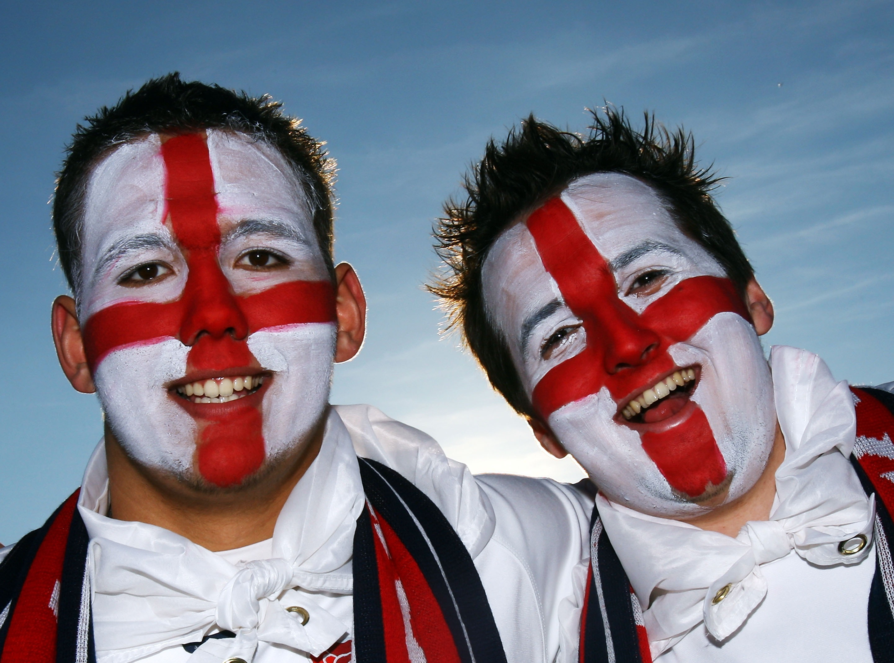
Questions
22
Notes:
Take the group through what we say we’ll do, then do, has a BIG impact slides
Ask the group to tell you what is the first thing that comes to mind when they see the brand on screen? Show all brands. The last brand shown is RWC2011. Click to show next slide.
Explain: Our reputation is the expectation from our visitors/clients and the experience they receive. Ask: what do you want them to say when the Rugby World Cup is long finish. Talk about the opportunities that we have and the role that we will play

Slide 23

23

Slide 24
