Slide 1
1. VIP Manager | Z
2. RNZ 2011 VIP Coordinator | F
3. VIP Admin | G
4. VIP Venue Manager | A
5. VIP Airport Host | T
6. VIP Host | E
7. VIP RWC Club Host | S
1. VIP Manager | Z
2. RNZ 2011 VIP Coordinator | F
3. VIP Admin | G
4. VIP Venue Manager | A
5. VIP Airport Host | T
6. VIP Host | E
7. VIP RWC Club Host | S
1. VIP Manager | Z
2. RNZ 2011 VIP Coordinator | F
3. VIP Admin | G
4. VIP Venue Manager | A
5. VIP Airport Host | T
6. VIP Host | E
7. VIP RWC Club Host | S
1. VIP Manager | Z
2. RNZ 2011 VIP Coordinator | F
3. VIP Admin | G
4. VIP Venue Manager | A
5. VIP Airport Host | T
6. VIP Host | E
7. VIP RWC Club Host | S

Slide 2
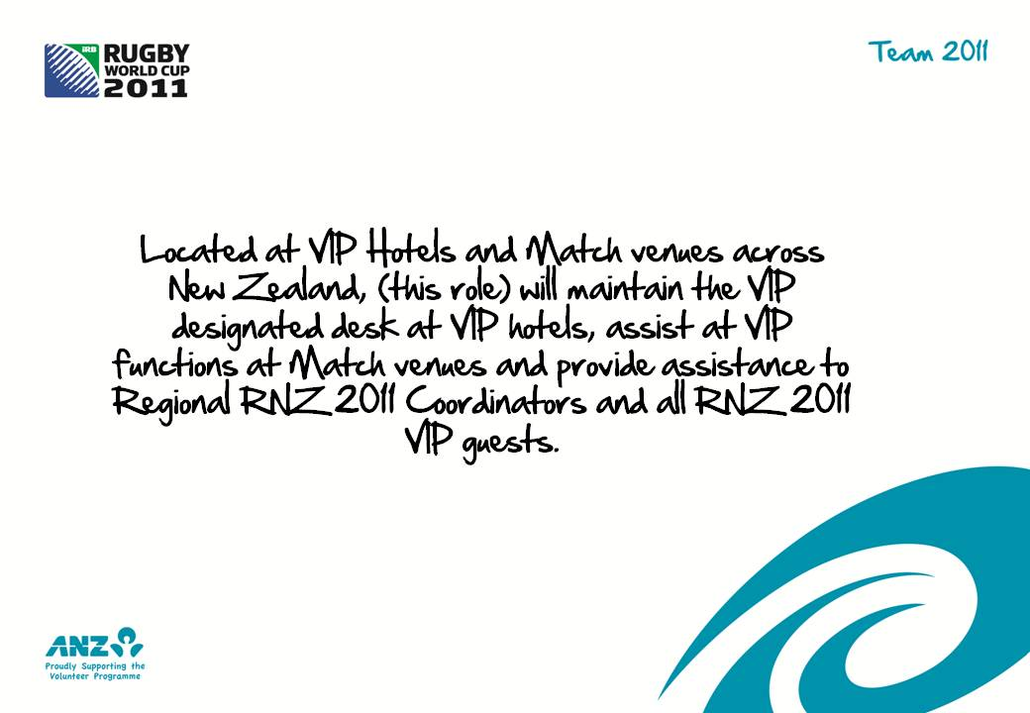

E
S

Slide 3

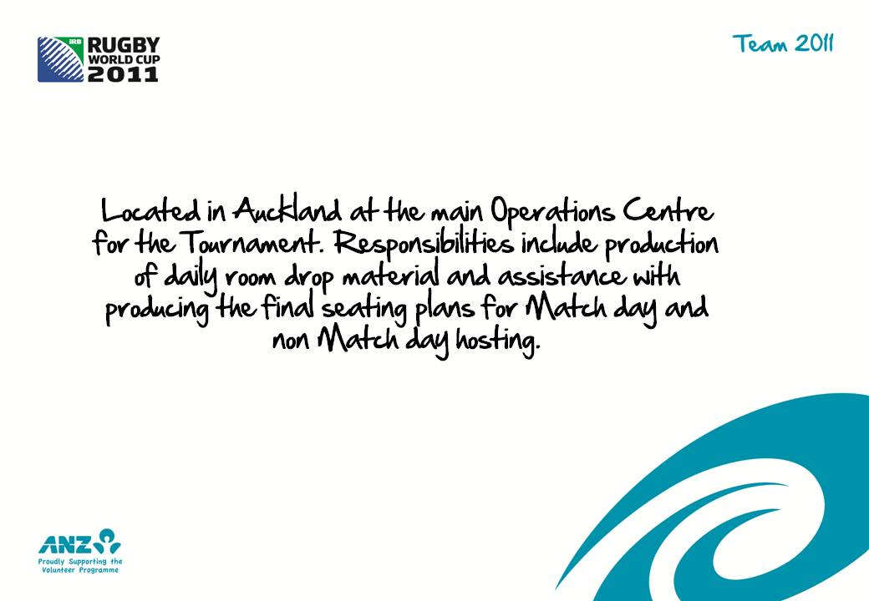
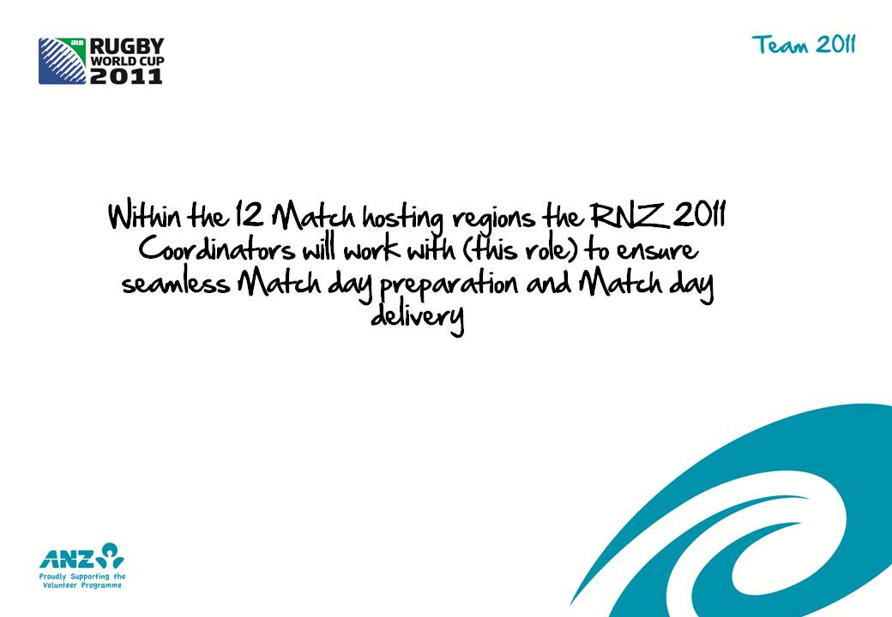

F
G
A
T

Slide 4




5
6
Z
7

Slide 5




3
1
2
4

