Slide 1
Team 2011
Team Leader Workshop
[date 2011]

Slide 2
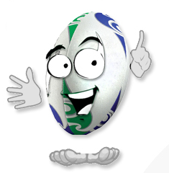
Welcome!

Slide 3
Our Focus Today - Agenda
Welcome
Rugby World Cup 2011, and the role of Team 2011
Volunteering in New Zealand – implications for leadership
Break
A day in the life of a team leader
Skill development
Logistics, and our role during remaining training
Wrap-up
3
Notes:
3

Slide 4



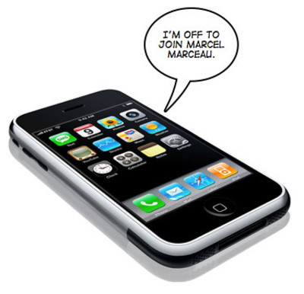
Making the most of our
time together
“Shhh...”
Notes:
4

Slide 5

Who’s Here?

Slide 6
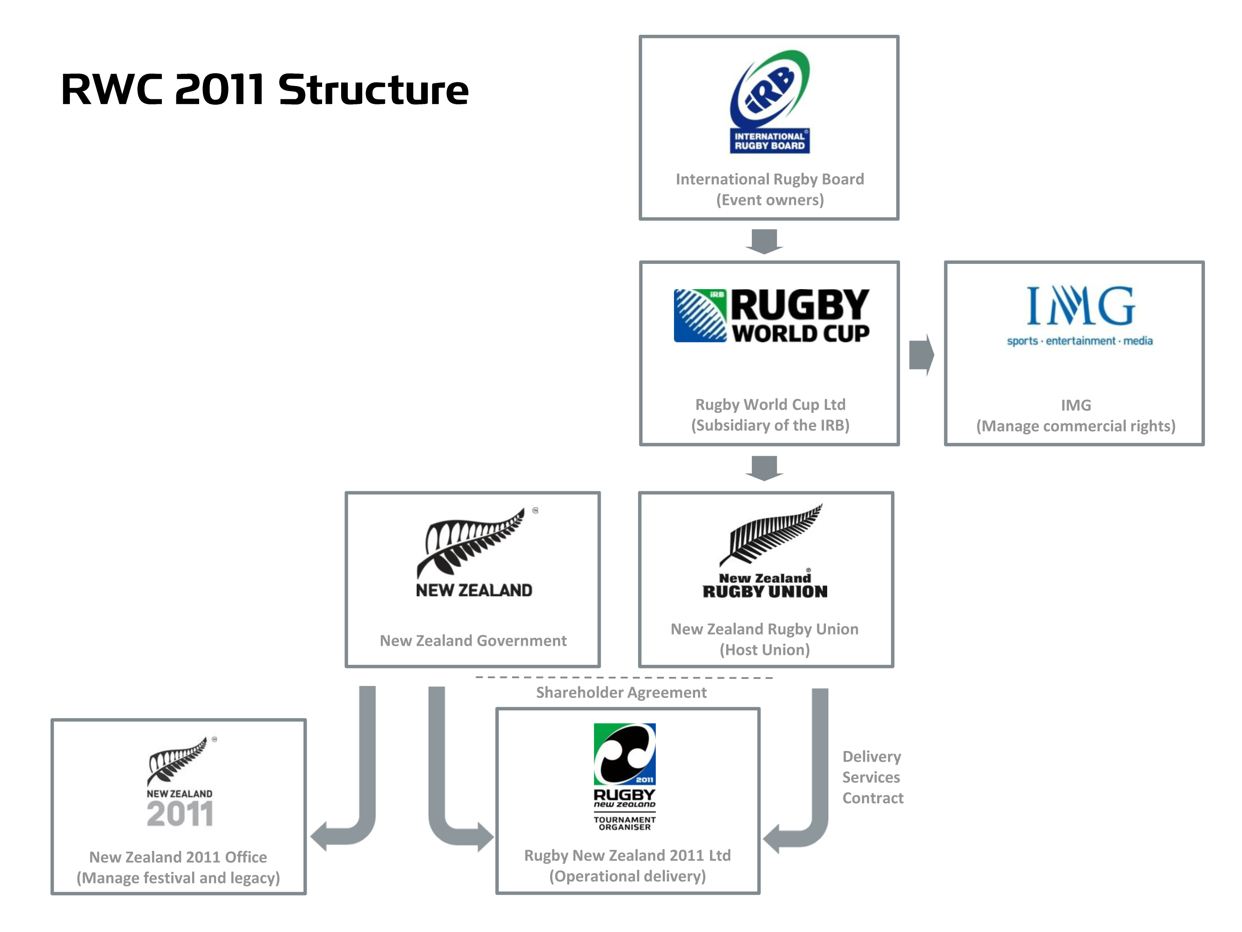
Team 2011

Slide 7
Team 2011
Over 1 million people are thought to be involved in some sort of volunteer work in New Zealand each year
6000 people – Volunteer NZ
Approx. 1000 Team Leaders
The ‘face’ of the Tournament
A group like no other ever seen in New Zealand
Critical to the delivery of Rugby World Cup 2011!

Slide 8
Functional Area ‘Fish’
At your tables, match the Functional Area names with the appropriate description.

Slide 9
Volunteering – Why we do it
Table discussion:
Why did we sign up, and say “Yes” to being involved in RWC 2011?
Capture points on paper

Slide 10
Volunteering New Zealand
Who they are
What they do – vision, mission
How to find out more information
www.volunteeringnz.org.nz

Slide 11
Policy To Protect Us
A volunteer means a person who does not expect to be rewarded for their work , and receives no reward for their work.
The Government recognises the important role volunteering has in society , and our economy
There are a set of policies in place to protect volunteers

Slide 12
Policy to protect us – cont.
Table Discussion:
At your table, agree what your allocated policy means, and how it relates to volunteers for Rugby World Cup 2011.
Prepare a 30 second presentation for the group about your policy. Be as creative as you like!
Privacy Act (1993)
RNZ 2011 Code of Conduct
Human Rights Act (1993)
RNZ 2011 Accreditation regulations
Health and Safety in Employment Act (1992)
Accident Compensation Act (2001)

Slide 13
Policy to protect us – cont.
Privacy Act (1993)
Volunteers must comply with this Act just as paid staff need to do (personal details, information about team members, etc)

Slide 14
Policy to protect us – cont.
Human Rights Act (1993)
This definition of ‘employee’ includes volunteers (unlike the Employment Act), allowing the Act to protect all volunteers in Team 2011.
You can not be discriminated against during selection of roles, or duties during the Tournament.

Slide 15
Policy to protect us – cont.
Health and Safety in Employment Act (1992)
All volunteers are covered by ‘Duty of Care’ within this Act.
Training, equipment and sufficient briefing must be provided to all Team 2011 members involved in work activities.

Slide 16
Policy to protect us – cont.
Accident Compensation Act (2001)
If volunteers also have paid work and get injured during their volunteer role, this Act provides compensation for your time off work.
If volunteers do not have other paid work, they are not entitled for weekly compensation if injured during their volunteered Team 2011 role.

Slide 17
“Your brand is your reputation. It’s what others say about you when you’re out of the room”
- Jeff Bezos, Founder, Amazon

Slide 18
Activity: Graffiti Wall
In pairs, walk around the room to the posters, and discuss each of the four ‘CARE’ words
Talk about each word, and add further words, pictures, song lyrics or phrases that describe what it looks like in action by us as leaders

Slide 19
A day in the life of a Team 2011 Leader...
Arrive at your workforce centre for check-in
Receive a list of your allocated team (as per rostering system)
Team briefing before start of shift (“TEAMtalk”)
Complete your shift, and ensure your team are watered, fed and motivated
Team debrief, and encourage sharing of experiences and stories (“THANKS”)
Escalate incidents

Slide 20
Rostering System
[screen shot examples of system and text message]

Slide 21

Listen up everyone!
“Right Here Right Now”
Be in your seat when the music ends!
– 4 minutes and 29 seconds!
Notes:
21

Slide 22
Time For A Break

Slide 23
Golden Rules for Team 2011 Leadership

Slide 24
Team Leader Tools
TEAMtalk briefing process
RWC feedback model
THANKS debriefing process

Slide 25
Team Leader Briefing - TEAMtalk
T
THANKS for your time
E
A story or EXPERIENCE
A
ACTIONS or changes we need to know
M
MEETING time for debrief, and break times
Where I will be if you need ME
What to be AWARE of today
An EXAMPLE of great work being done by Team 2011
Introductions around the TEAM

Slide 26

2. RWC Feedback
Team 2011 Leadership Programme
‘RWC Feedback’
1. REAL EXAMPLE OR STORY
2. WHAT WAS THE IMPACT?
3. CHANGE OR CONTINUE?

Slide 27
Team Leader Debrief – THANKS!
T
THANK YOU!
Thanks for your time and effort today
H
HIGHLIGHTS from the day
A
ACTIONS
How to share what we’ve achieved today with Team 2011. Facebook, Workforce Center?
N
K
S
NOTIFICATION
Were there any incidents that need escalating?
KIT and Admin
Does everyone know their next shift time? Remember to keep your uniform tidy.
SEE YOU NEXT TIME!
Thanks again for your great work
Share a story of great visitor service you heard about or saw from the team

Slide 28
Putting It All into Action
Instructions:
In groups, move to some space, discuss the tool and how it may be similar to management processes you already know
Agree a scenario/environment during the Tournament (have some fun with it!)
Decide in your group who will play each role (Leader, team member/s, observer) and practise the tool
Rotate roles a couple of times
Before time is up, discuss what’s important to delivering the tool well
Come back ready to present your learnings to the group – and maybe show off your skills!

Slide 29




facebook.com/rugbyworldcup
twitter.com/rugbyworldcup
youtube.com/rugbyworldcup
flickr.com/rugbyworldcup

Slide 30
