Slide 1
Snacktivities for Running Active Schools

Slide 2
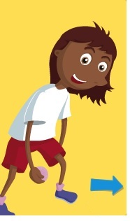
With a Koosh ball can you…?
  Toss the ball from side to side
  Pass the ball
    behind your legs
    in a figure of eight
  Throw up and catch the ball like knuckle bones on the back of your hand
  Pass the ball with a partner using
    two hands
    your left hand
    your right hand

Slide 3
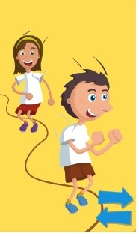
With a skipping rope can you…?
  Make a circle
  Make a square
  Make a triangle
  Make a rectangle
  Make a parallelogram
  Make a pentagon
  Make an octagon
  Make a semicircle

Slide 4
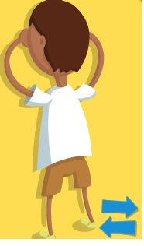
Can you balance by yourself on…?
  One foot
  One foot, one hand
  Your bottom
  Two feet and your bottom
  Two hands, one foot, one knee
  Two hands, two feet

Slide 5
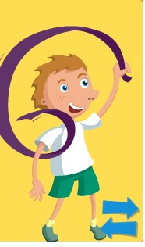
With a ribbon can you…?
  Use your right hand and pretend to:
    paint the walls
    write your name
    make snakes
    make spirals
    make side waves
    make circles
  Use your left hand and do the same

Slide 6
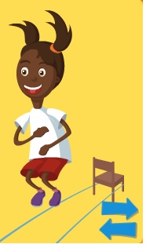
With a chair can you…?
  Stand up, sit down, stand up 3x
  Step side to side while holding your chair in front of you
  Raise your legs one at a time with bent knees while sitting
  Pretend to peddle a bike while sitting
  Move your legs in and out while sitting
  Make movement combinations using arms
  and legs
  Circle the chair by:
    walking
    skipping
    jumping

Slide 7
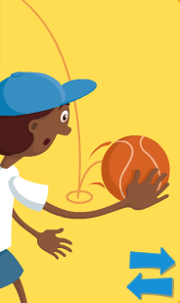
With a ball can you…?
  Roll the ball from your toes to your head
  Make the ball circle you body
  Stand up and bob down while bouncing the ball
  Lift and pass the ball as slowly as you can

Slide 8
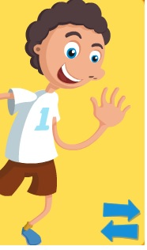
With a feather can you…?
  Keep the feather in the air
  Write your name with the feather in the air
  Balance the feather on your nose, elbow, knee, shoulder, foot
  Pass the feather to your partner using your hands, knees, under armpits

Slide 9
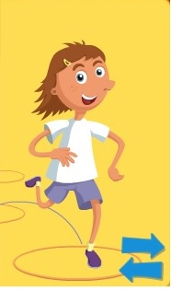
In a group of three or four can you…?
  Collect 10 hoops and set the hoops out to look like a hopscotch
    Hop through the hoops like hopscotch
    Re-arrange the hoops into different patterns
    Find different ways to travel through the hoops
  Think about:
backwards | sideways
upside down | hands and feet
fast | slow
wide | narrow

Slide 10
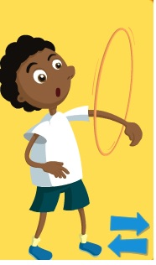
With a hoop can you…?
  Put it on the ground and:
    walk around balancing on it
    run around it
    run three times one way and three times the other
    sparrow jump in and out of it like a nest
    jump backwards
  Sit in the hoop and make your toes go round it without touching the ground with your hands

Slide 11
In pairs can you…?
  Seesaw
    Face each other and join hands
    Squat down while the other person remains standing, then swap
    Move up and down with one squatting while the other rises
    Try jumping into the air at the end of the rise

Slide 12
With elastic can you…?
  (Use a three metre length of elastic with ends sewn/knotted together)
  Stand two meters apart, within the elastic circle, stretching it between each other
  Jump in and out of elastic at various heights (ankles, knees, hips and underarms)
  Land with legs either side of the elastic
  Kick up and over elastic while jumping
  Perform turns when jumping

Slide 13
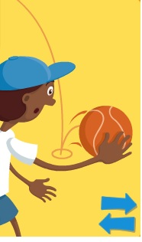
With a ball can you…?
  Roll the ball along the ground, pushing it with your:
    hand
    foot
    knee
    shoulder
    elbow
    head
    Nose
  Roll the ball over your body from head to toe, around your body and up and down the arms

Slide 14
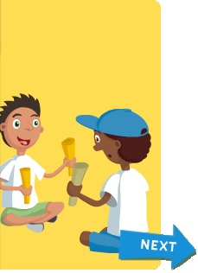
With some rolled up magazines can you…?
  Make some sticks for tītītōrea (stick games)
  Roll up a magazine tightly and use masking tape to secure the middle and ends
  Tap the sticks in time to music
    Ki runga – up
    Ki raro – down
    Ki mua – in front
    Ki muri – behind
    Ki te taha – to the side
    Ki te taha matau – to the right
    Ki te taha mauī – to the left

Slide 15
With some rolled up magazine sticks can you…?
  Try some tītītōrea (stick games) with
  a partner
    Tap the floor, tap together and tap alternatively the right and left of your own sticks
    Tap the floor, tap together and tap alternatively the right and left with your partner’s sticks
    Tap the floor, tap together and swap alternatively the right and left with your partner’s sticks
  Make up your own actions

Slide 16
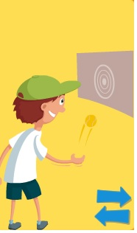
In groups of four can you…?
  (Use chalk to draw on a wall a variety of targets displaying numbers from 1 to 10 – circles, squares, shapes, snakes)
  Use a wet tennis ball, line up and take turns
    Throw underarm to hit the highest number on
    a target
    Collect the ball and go to the end of the line
    How many points did your team score?
  Set a total to achieve. Vary the distance you stand
  from the target

Slide 17
With a ball can you…?
  Move while holding the ball:
    between your knees
    between your elbows
    with your wrists
    with fewer and fewer fingers
    up high and down low with the right then left hand
  Throw and clap and catch – increase the number of claps each time you are successful

Slide 18
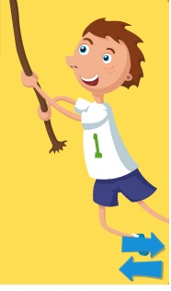
Moving in different ways can you…?
  Run around a set area in time to the music playing
  Jump forwards, backwards, sideways, from line to line
  Count how many hops or jumps it takes to get to a set area/line
  Jump like a frog, squat with legs apart, arms in between
  Combine movements, run, skip, jump, and walk (e.g. six steps of each)
  Skip/walk/run at different speeds, in a circle (can you skip/walk/run backwards?)

Slide 19
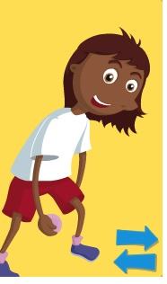
With a beanbag can you…?
  Balance a beanbag on different parts of your body
  Walk with the beanbag on your head
  Sit down without letting the beanbag fall from your head
  Throw the beanbag, clap, and then catch it again
  See how many times you can clap while the beanbag is in the air

Slide 20
With a beanbag can you…?
  Sit down on the ground, throw the beanbag in the air and quickly stand to catch it
  Throw the beanbag in the air, then turn around and catch it
  Hold the beanbag between your knees and jump up and down without dropping it (try 5x, 10x, 20x)

Slide 21
With a beanbag can you…?
  Work with a partner to
    throw and catch the beanbag (changing distance, hight of throws)
    practice your counting or times tables as you pass the beanbag
  Throw the beanbag to land in a hoop at different distances
  Work in small groups to keep one beanbag up in the air without letting it touch the ground. The same person is not allowed to touch it twice in a row

Slide 22
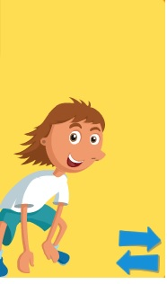
With your body can you…?
  Make yourself:
  as small as a mouse
  as big as an elephant
  as still as a rock
  as tall as a tree
  move like your favourite animal
  e.g. hop like a rabbit, creep like
  a tuatara
  sway like a tree in the wind

Slide 23
In pairs can you…?
  Sit down and face each other, soles of feet on the floor, toes touching
  Reach forward to grasp hands
  Pull together and both come up to stand and return to sitting position again
  Try the same activity in groups

Slide 24
In pairs can you…?
  Sit back-to-back, knees at chest
  Link elbows and on ‘go’, without moving feet, push against each other to stand
  Sit down again with elbows linked
  Work in groups to do the same activity

Slide 25
In pairs can you…?
  Make a mirror image by:
  standing facing one another
  one person moves their hands with their palms facing the other person
  the other person mirrors the actions
  change roles
  try moving other parts of the body

Slide 26
In small groups can you…?
  Move freely around a chosen area
  On a signal make groups of three
  Make the letter that the caller indicates using your bodies (E, T, H, K, L, M, N, F, V, Z, and O all work well)
  Make shapes with your bodies that look like
  A chair
  A table
  A bicycle
  A waka

Slide 27
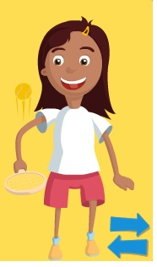
With a racquet ball can you…?
  Hold the racquet like a frying pan and balance a tennis ball on it
  Walk balancing the ball on the racquet
  Sit down without letting the ball fall from the racquet
  Turn around without letting the ball fall from the racquet

Slide 28
With a racquet ball can you…?
  Put the ball on the ground and move it around using the racquet, always keeping the racquet in contact with the ball
  Bounce the ball on the racquet
  Hit the ball up with the racquet and catch the ball with your other hand
  Hit the ball in the air let it bounce once and then catch it with your other hand

Slide 29
With a ball can you…?
  In pairs
  Pass the ball between each other and take turns calling out each letter in the alphabet
  Practice your spelling words as you throw and catch

Slide 30
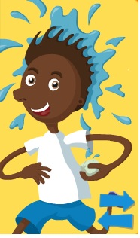
With a balloon can you…?
  Tap the balloon with one hand to a destination
  With both hands behind your back, use other body parts to tap the balloon to a destination
  Tap two balloons alternately to a destination without the balloons touching the ground
  Do the same thing with one hand behind your back

Slide 31
With a rope can you…?
  Walk along the rope
  Walk backwards along the rope
  Jump from side-to-side along the rope
  Criss-cross walk along the rope. Start standing on one side of the rope and cross outside foot over top of rope so as legs are crossed, continue to do this alternating feet crossing the rope, feet do not touch the rope
  Incorporate right hand touching left leg as it crosses the rope and left hand touching right leg as it crosses the rope

Slide 32
With a rope can you…?
  Carry a beanbag on your head as you walk along the rope
  Carry a beanbag between your knees as you jump across the rope
  Make a letter of the alphabet or a number with your rope
  Walk on your hands and feet either side of the rope without touching it

Slide 33
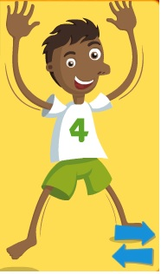
With different coloured balloons can you…?
  Keep the balloons up in the air without touching the same balloon twice in a row
  Keep the balloons up in the air using alternate hands when tapping the balloons
  In groups of five:
    see how long you can keep a balloon up in the air without letting it touch the ground
    as you get better add another balloon
    you may not touch the same balloon twice

Slide 34
In pairs can you…?
  Balance with a partner
  Stand upright, one foot forward, palms touching
  On ‘go’ attempt to move your partner off balance
  Take one or several steps back and lean on each other to maintain balance, then attempt to push each other back up to standing position – feet do not move

Slide 35
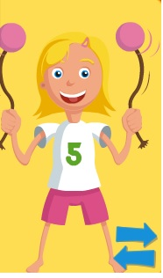
With a poi can you…?
  Move while swinging the poi:
  Forward and backwards
  Stamp your feet
  Side step
  Bob up and down
  Turn around

