Slide 1
Sport NZ
Finance Report
31 January 2019

Slide 2
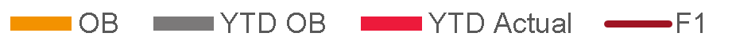

Current year performance
Revenue and Investments
Operational Expenditure
Operating Expenditure
Status | Commentary
 | Investments ahead of budget due to an earlier than expected draw down by HPSNZ of their funding – timing difference only. Revenue is tracking inline with budget expectations, while personnel is slightly behind budget due to the restructure of the Intelligence Team being completed later than planned and due to vacancies in the Marketing & Communications team. Professional and Technical services underspent by $0.5m mainly due to delays in Strategy, Policy and Corporate and Intelligence team. Sector training delays across Community Sport, primarily in Young Peoples due to minor delays the play.sport expansion workshops and in Sports Development

Slide 3
Balance sheet
Capital Expenditure
HP Infrastructure
Cash Forecasting
Status | Commentary
 | Computer software - Community Sport Systems are on track for development to begin inline with forecast expectations.
Status | Commentary
 | Current year projects on track with the exception of Avantidrome and HP Sailing Centre.
Status | Commentary
 | Forecast reflects quarterly funding peaks

Slide 4
Long-term financial stability
Out year deficit
Forecast funding gap
Out year forecast equity
 | 18/19 | 19/20 | 20/21 | 21/22 | 22/23
Opening Equity | 36,696 | 31,838 | 25,793 | 21,453 | 17,692
Sport NZ Deficit | (4,858) | (6,045) | (4,339) | (3,761) | 29
Closing Equity | 31,838 | 25,793 | 21,453 | 17,692 | 17,721
Status | Commentary
 | Lotto revenue forecast has been reduced by $1.4m since last reported due to the lack of jackpot lotto draws. This has been offset in outyears with continued increases in forecast LottoNZ profits for out-years. Out-year forecast is still tracking to minimum equity levels by 2023. The current high equity levels will enable the Board the opportunity to increase investment into the sector with the launch of the new Sport NZ Strategy. Potential allocations across new strategic priorities will be discussed at the April Board meeting.

